Slide 1
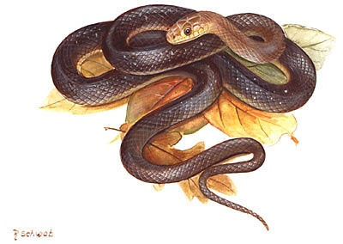

Snakes in the Garden
Vincent Mannino, County Extension Director, Fort Bend County
Lee Freeland, Jefferson County Master Gardener

Slide 2
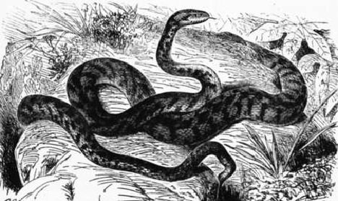
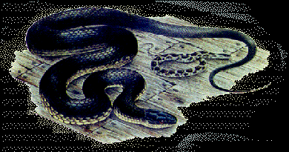
Snakes in the Garden
A brief description
Type of Snakes Often Encountered
Identification
Habitats, Habits & Facts About Snakes
First-Aid Techniques

Slide 3

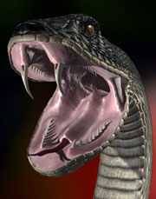
Poisonous snakes are generally classified by the type of venom that they inject into their victims
The first is a HEMOTOXIC venom (Hemo means blood)
The second is a NEUROTOXIC venom (Neuro means nerve)

Slide 4
In the Gulf Coast Area of Texas we have snakes that possess both types of venom – that is:
The pit vipers injects the hemotoxic venom that is toxic to the blood.
The coral snake injects the neurotoxic venom that is toxic to the nerve.

Slide 5
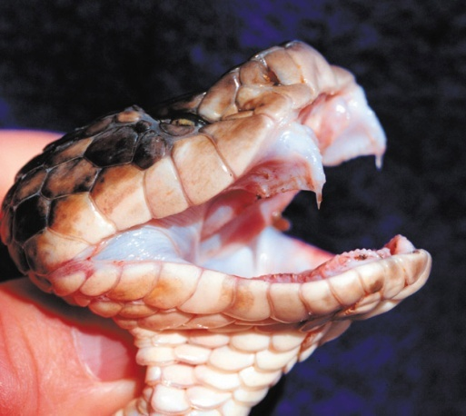
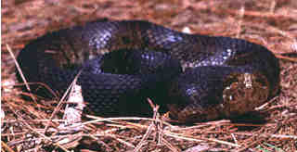
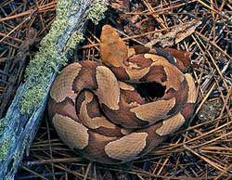
Snakes that inject hemotoxic venom
The pit vipers – this family include:
The Mocassins –
Cottonmouth or Water Mocassin
& Copperhead

Slide 6
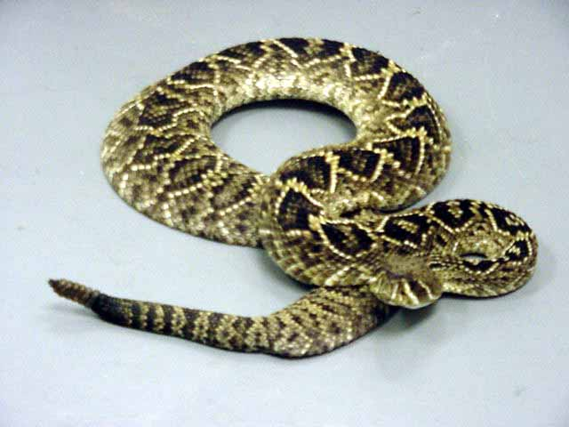
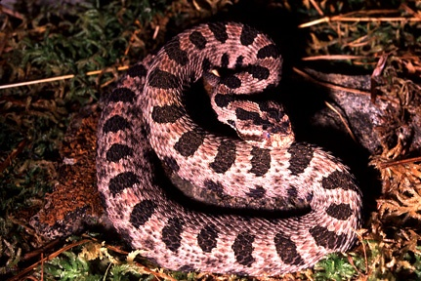
Snakes that inject hemotoxic venom
The pit vipers – this family also include: The Rattlesnakes –
Diamondback, Timber,

Slide 7
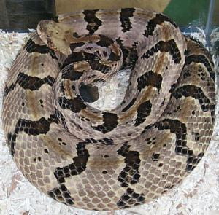
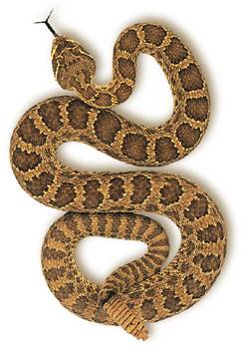
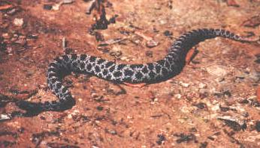
Snakes that inject Hemotoxic venom
More Rattlesnakes –
Canebrake, Prairie, & Pygmy

Slide 8
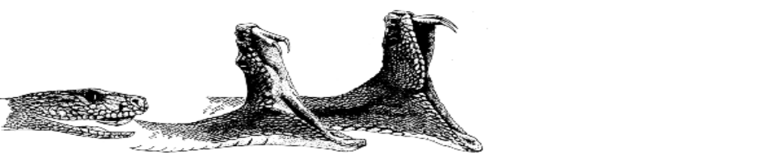
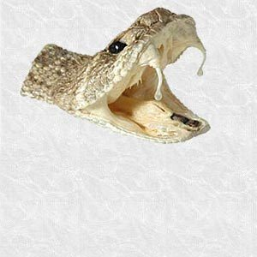
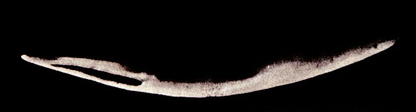
Characteristics of the pit viper
Can open its mouth very wide
Have rather large, long fangs for injecting venom
Are generally more easily irritated and aggressive in nature

Slide 9
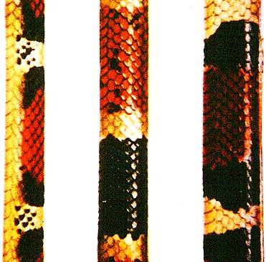
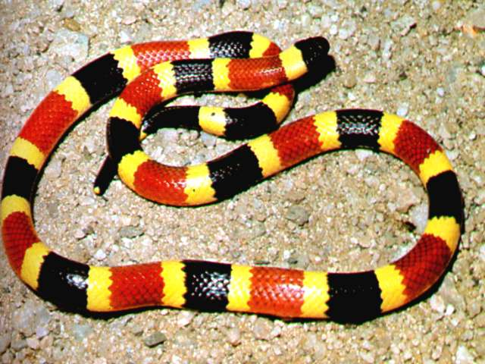
The Snake that inject Neurotoxic venom is:
The Coral Snake
“Red on yellow, kills a fellow…..”
Scarlet Snake Coral Snake Scarlet King S.

Slide 10
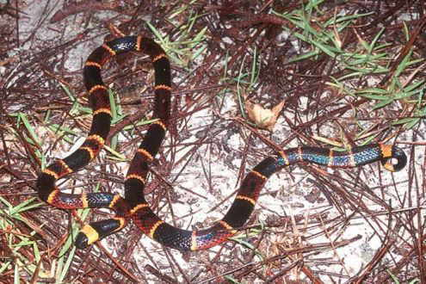
Characteristics of the coral snake
Is secretive and not very aggressive in nature
Cannot open its mouth very wide
Has very sharp teeth

Slide 11
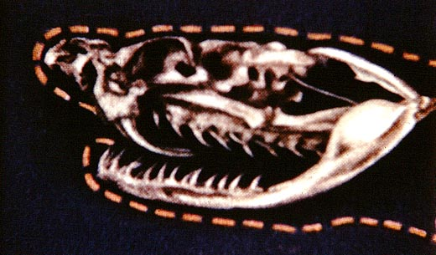
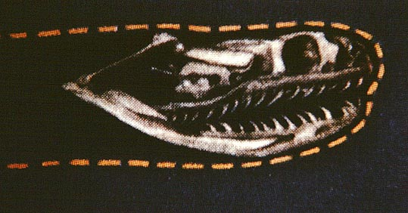
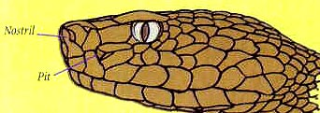
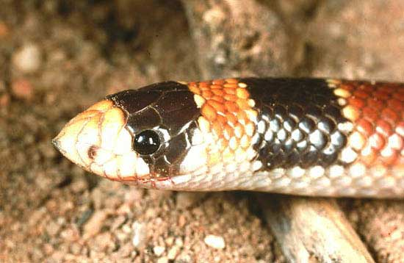
Poisonous versus Non-Poisonous
The Differences:
Poisonous Snakes Non-Poisonous
Fangs and few teeth
versus
many teeth
Pits versus no pits

Slide 12




Poisonous versus Non-Poisonous
The Differences:
Poisonous Snakes Non-Poisonous
(cont.’d)
Slitted pupils
versus round eyes
Angular head
versus rounded head

Slide 13
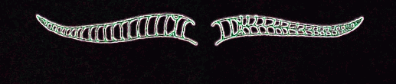
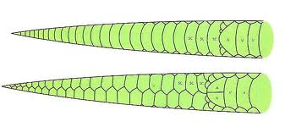
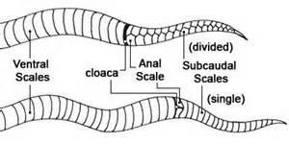
Poisonous versus Non-Poisonous
The Differences:
Poisonous Snakes Non-Poisonous
(cont.’d)
Single-row vs. double-row
of subcaudal scales

Slide 14
Snake Facts or Fiction?
Every bite is fatal!
Wrong – Not every bite results in venom release. Also, length of time since last venom release is important.
Season of the year has nothing to do with venom release! Wrong - Less venom is released in the fall than in the spring. The size of the victim is very important.
A snake cannot bite under water!
Wrong - They can eat under water and can bite under water.
A snake will protect their young!
Wrong - Snakes have no parental instinct. When a snake opens its mouth it is to eat their young, not to sing to them.

Slide 15
More Snake Facts or Fiction!
Counting the number of rattles will give an idea of its age! Wrong - A rattlesnake will add a new rattle each time it sheds its skin (2-4 times a year) and to complicate matters the rattles break off easily.
Snakes hibernate in dens!
Right - As many as 50-75 may hibernate together.
The color of its victim has nothing to do with its strike! Wrong – Light colored animals and light colored clothing reflects more heat than dark. Thus, will be struck at quicker.
Snakes can strike at great distances!
Wrong – A snake can strike only 1/3 – 1/2 of its body length. And, from a coiled position only.
Snakes are predictable! Wrong – Expect the unexpected!!

Slide 16
Signs and Symptoms: Pit Vipers
Immediate pain and burning at bite site
Within a few minutes redness and swelling develops
Bite site develops a purplish discoloration
Nausea and Vomiting
Dizziness
Weakness
Sweats and chills
Metallic or rubbery taste in mouth

Slide 17
Signs and Symptoms:
Coral Snakes
Generalized symptoms (drowsiness, weakness) may be delayed 1-8 hours
Numbness at bite site
Blurred vision
Slurred speech
Salivation
Seizures

Slide 18
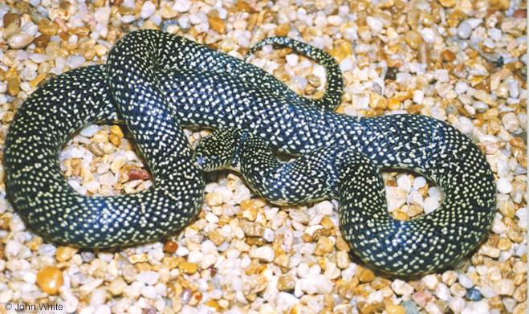
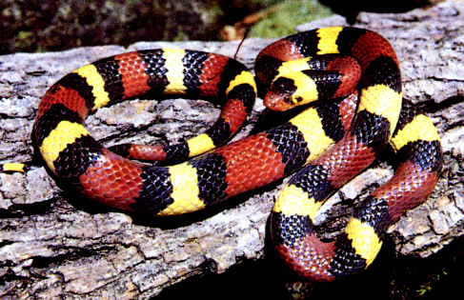
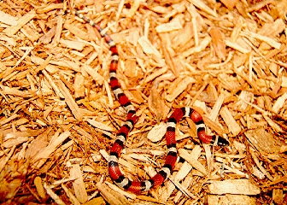
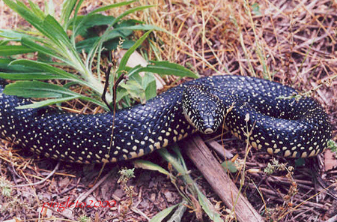
Snake ID – Non-Poisonous Snakes
“The Kingsnakes”
Speckled Kingsnake Scarlet Kingsnake
Louisiana Milksnake Black Kingsnake

Slide 19
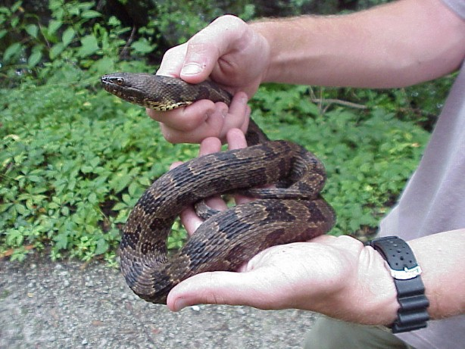
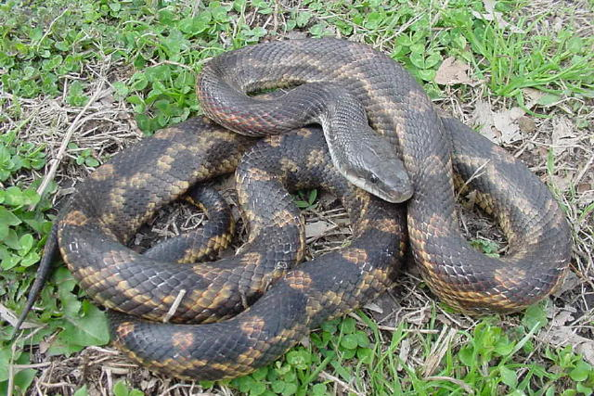
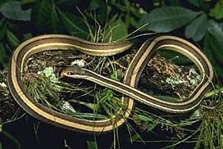
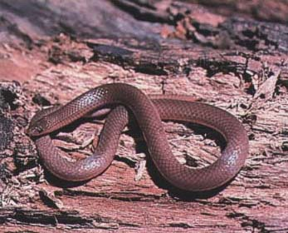
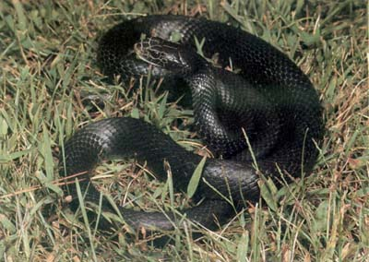
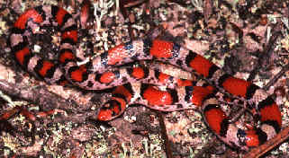
Non-Poisonous Snakes
Others:
Water Snake Texas Rat Snake E. Ribbon Snake
Wormsnake Black Racer Scarlet Snake

Slide 20
Snake Safety
If you are not 100% absolutely certain of the identification, then LEAVE IT ALONE!
We are most likely to be bitten on the hand, lower arm, lower leg, ankle and foot.
Wear tall leather boots and work gloves when working outdoors.
Be aware that snakes rest during the day, and hunt late afternoon or early evening.
Pit vipers are generally more aggressive in nature than the coral snake and non-poisonous snakes.

Slide 21
Snake Hideouts
“Let a sleeping snake lie”
Firewood stacked directly on the ground.
Old lumber or junk piles.
Garden and flower beds with heavy mulch and/or ground covers.
Untrimmed shrubs and shrubs growing next to a foundation.
Unmowed and unkept lawns, abandoned lots, and fields with tall vegetation.

Slide 22
Snake Hideouts
(cont’d)
Pond and stream banks where there is abundant debris or trash.
Attics with a rodent, bird, or bat problem.
Feed storage areas in barn hay lofts where rodents may be abundant.
Wall voids and crevices.
Empty plant pots and other containers.

Slide 23

First Aid
When bitten, you must remain calm. The more you panic the faster blood circulates.
While you are remaining calm, attempt to determine if you were actually bitten by a poisonous snake.
If it was indeed a poisonous snake, kill it or have someone kill it for you. The save the snake for accurate identification.

Slide 24
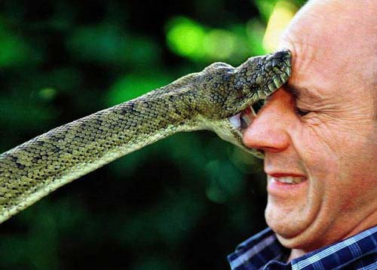
Place a constricting band (not a tight tourniquet) just up from the bite.
Elevate the wound area above the shoulders to slow circulation and utilize an ice pack.
If bitten on the face do not use a constricting band around your neck. Consider the ice treatment here. And, pray – pray hard!
Get to a doctor as rapidly as possible.
And, bring the snake!

Slide 25
THE END!
Questions ?
This presentation is intended for educational use only. Photographs and charts were found at various educational website nationwide.
Educational programs of Texas A&M AgriLife Extension Service are open to all people without regard to race, color, sex, disability, religion, age, or national origin.

