Slide 1
Don’t “Bug” Me!
Pests of Plants
Created By:
Vincent Mannino
County Extension Director
Fort Bend County

Slide 2
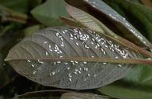
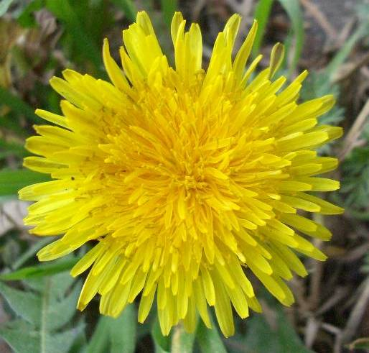
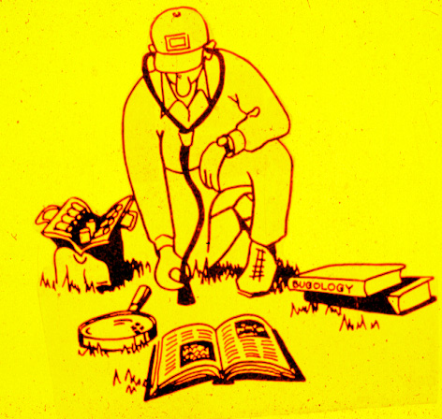
Pest Facts!
Pests are all life forms destructive to plants.
Pests complete with people for food & fiber.
Pests interfere with the culture of desirable plants.
Identification is the key- without proper ID we would not know how to control the pests!

Slide 3
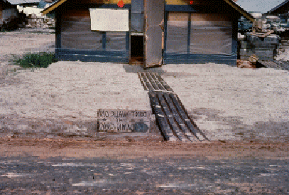
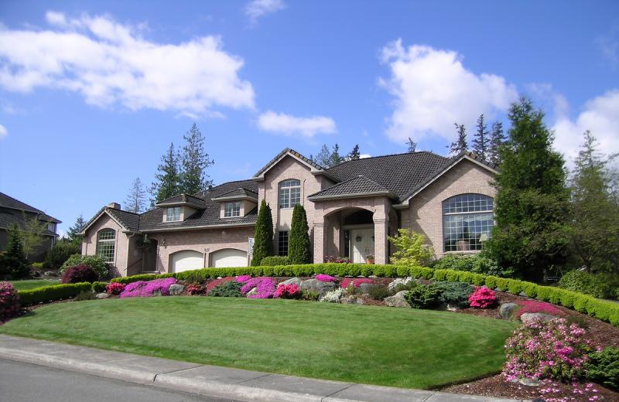
Pest levels – of concern
Sometimes pest present more problems
And, sometimes pest present less problems
Pest problems and concerns depend on expectations!
Low Expectations = low concern
High expectations = high concern

Slide 4
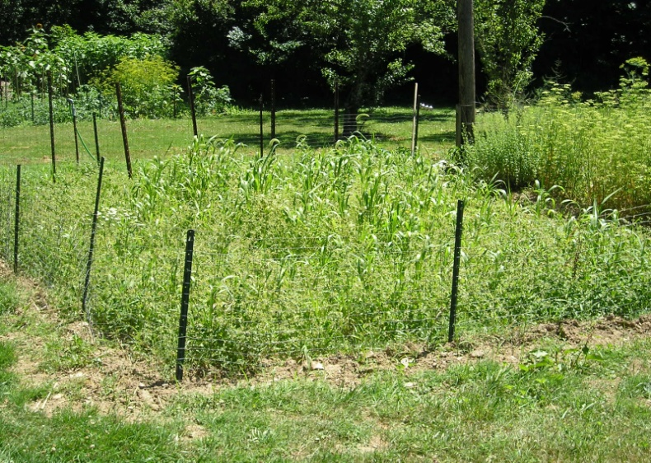
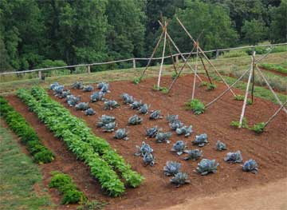
Pest levels – of concern
Sometimes pest present more problems
And, sometimes pest present less problems
Pest problems and concerns depend on expectations!
Low Expectations = low concern
High expectations = high concern

Slide 5
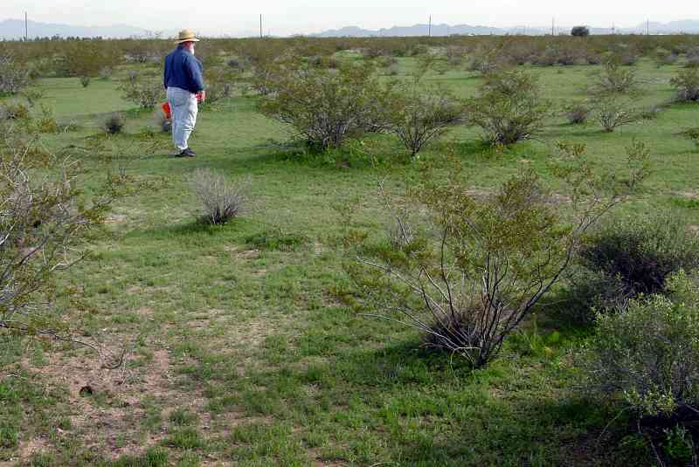
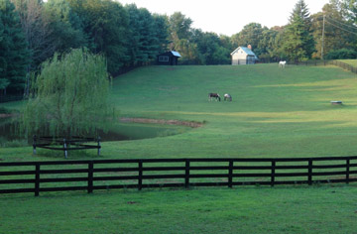
Pest levels – of concern
Sometimes pest present more problems
And, sometimes pest present less problems
Pest problems and concerns depend on expectations!
Low Expectations = low concern
High expectations = high concern

Slide 6
Decision Tree for Pest Control
Do You
Have a Pest
Problem?
NO
Do You Care?
NO
YES
YES
Don’t Mess With It!
Practice Good IPM
Are you certain?
Can you
Identify it?
YES
YES
Do you know how to control?
2
NO
NO
Do you know
the product
and rate?
YES
Pest Not Controlled
or
Misuse of Pesticide!
Do you know
A reference
or resource
to use?
NO
Will you?
NO
Hire a qualified
Landscape
Professional
YES
NO
NO
NO
Can you calibrate and
Apply the right rate?
Can you aquire info
And do what’s needed?
YES
YES
YES
NO PROBLEM!

Slide 7
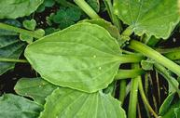
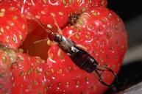
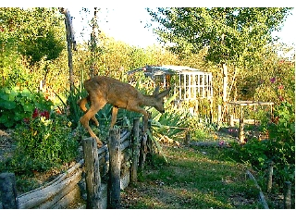
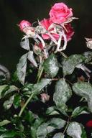
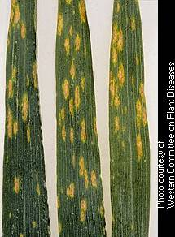
Four groups of Plant Pests
Weeds
Invertebrates Insects
Disease Agents
Vertebrates

Slide 8
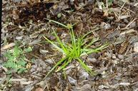
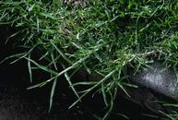
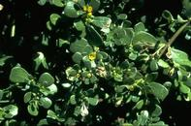
Weeds
Weeds are undesirable plants- “any plant growing out of place”
Weeds compete for light, nutrients, water and space
Interfere with farming/gardening
Harbor insects & disease
Very persistent and often difficult to eradicate

Slide 9
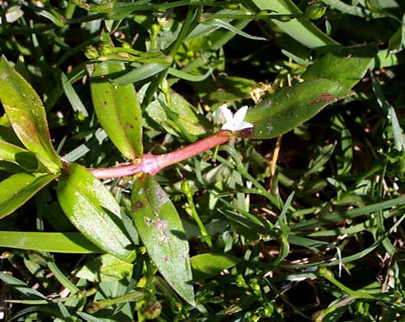
Identification is Key!
If you want to get rid of weeds, you must know how to identify them and understand their life cycles.
Life Cycles:
Biennial - Survives for 2 growing seasons
Perennial - Survives for many years.
Annual - Survives only one season.
  Winter annual
  Summer annual

Slide 10

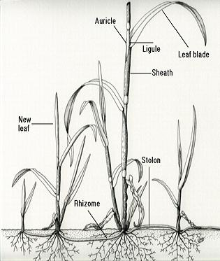
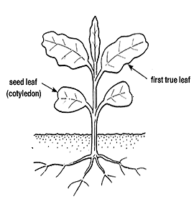
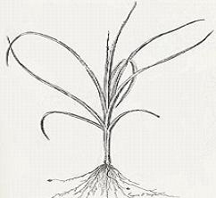
Categories of Weeds
Grass
Broadleaf
Sedge

Slide 11
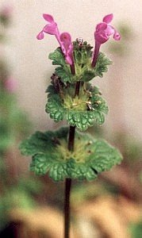
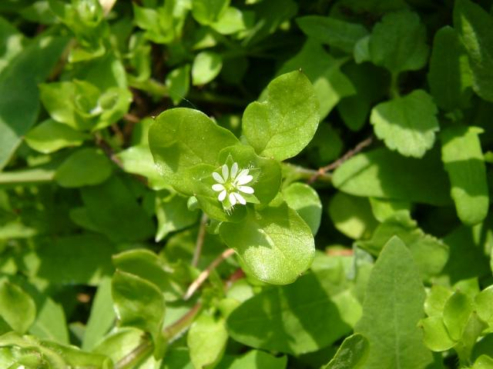
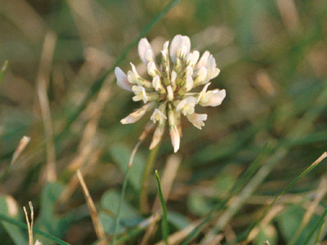
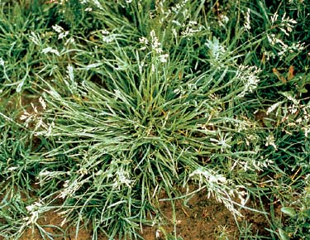
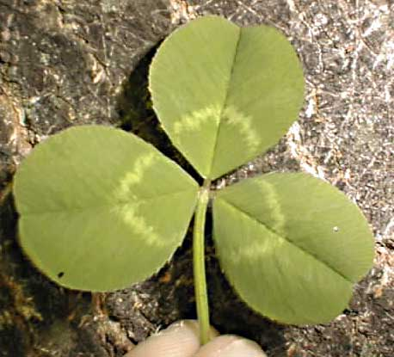
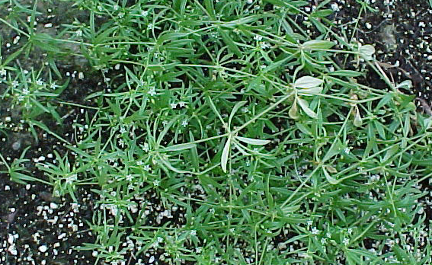
Weeds – Winter Annuals
Chickweed
Clover
Henbit
Bedstraw or Carpetweed
Annual Bluegrass

Slide 12
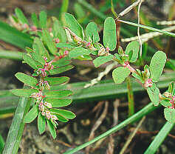
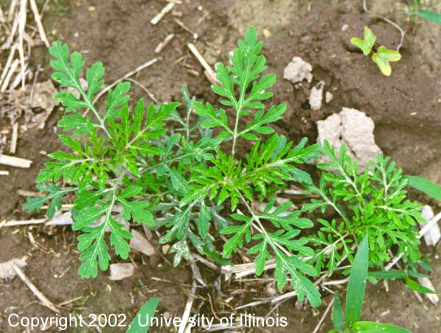
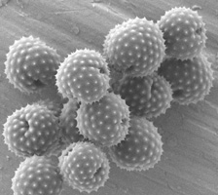
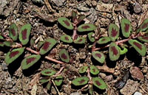
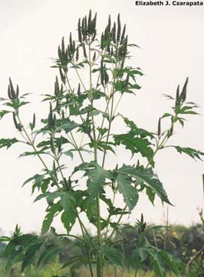
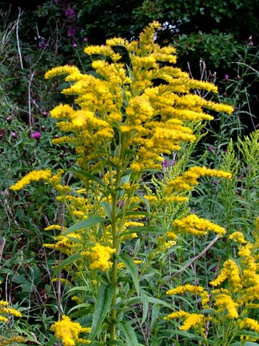
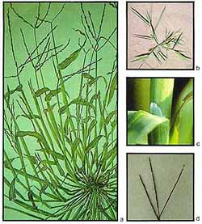
Weeds – Summer Annuals
Spurge
Ragweed
Crabgrass
Goldenrod
Ragweed

Slide 13
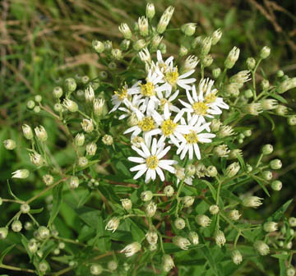
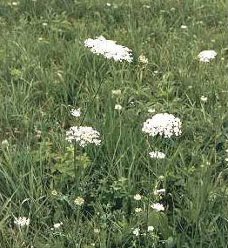
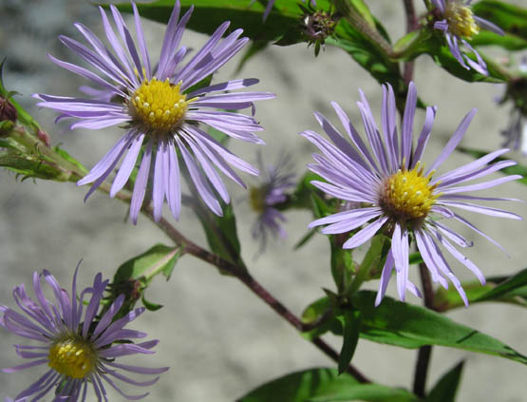
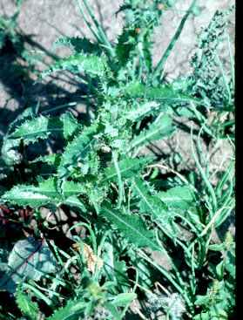
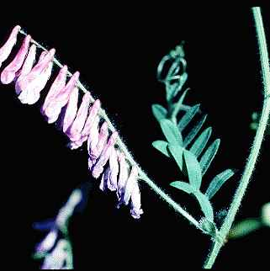
More Annuals
Asters
Queen Anne’s Lace
Vetch
Annual Sow Thistle

Slide 14
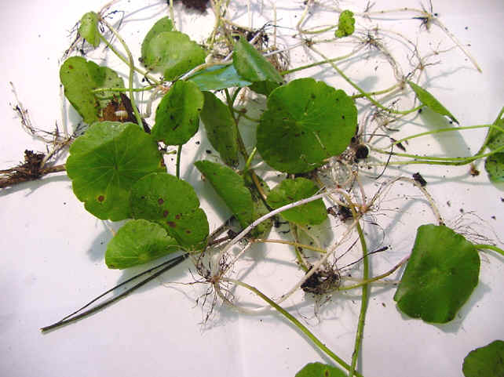
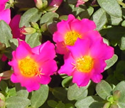
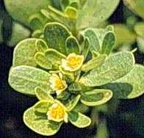
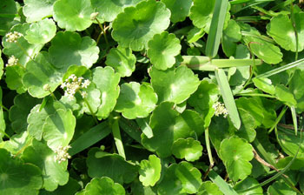
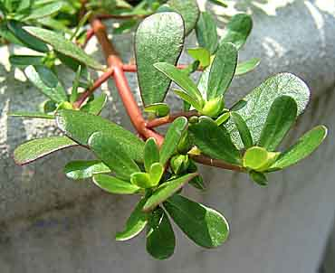
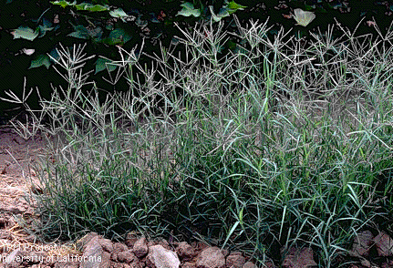
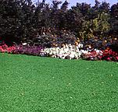
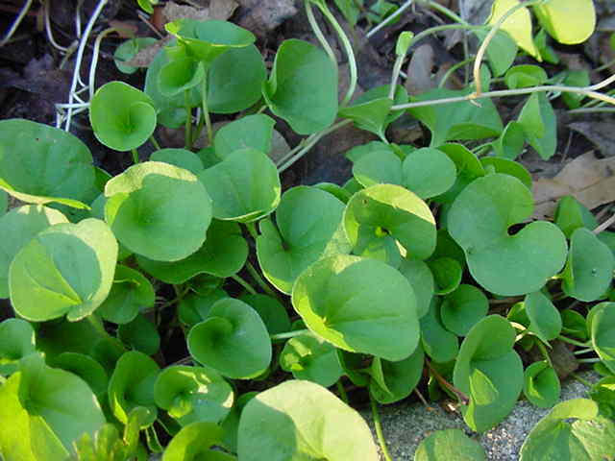
Perennial Weeds
Dollarweed
Bermudagrass
Purslane
Purslane
Dichondra

Slide 15
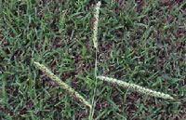
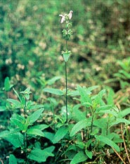
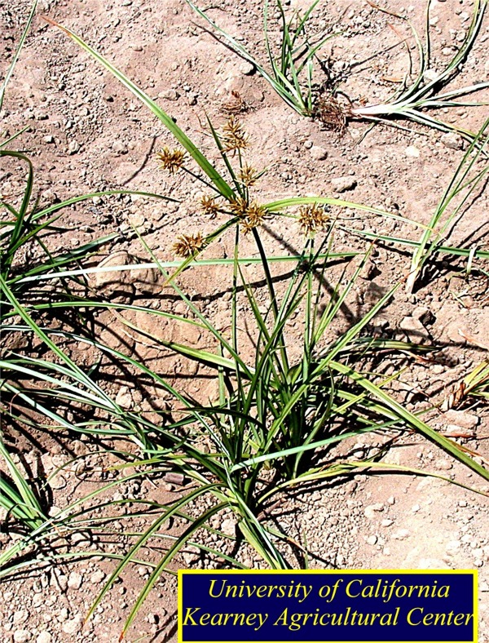






Perennial Weeds
Purple Nutsedge
Dallisgrass
Florida Betony
Wild Strawberry
Dandelion

Slide 16


Disease Agents
Disease Agents cause disease in plants and animals. They include:
    Bacteria
      Fungi
        Viruses
Fire Blight is a bacterial disease of fruit trees.
Disease

Slide 17


Powdery Mildew (fungus)
Common Hosts
  Crapemyrtle, Euonymous, Rose, Dogwood
Symptoms
  White “fuzzy patches” on plant surfaces, mostly aesthetic
Control
  Use resistant varieties, avoid wetting, use sanitation,
  Chemicals: Myclobutanil, Propiconazole, Triforine, Triadimefon

Slide 18




Slide 19


Blackspot (fungus)
Common Hosts
  Rose
Symptoms
  Black leaf spots w/ feathered margins
  leaf chlorosis, defoliation
Control
  Resistant varieties, sanitation,
  Chemicals: Triforine, Myclobutanil, Chlorothalonil

Slide 20


Twig Blights (various fungi)
Common Hosts
  Various woody ornamentals e.g. Junipers
Symptoms
  Surface lesions, random dieback of twigs, twig tip dieback
Control
  Sanatation pruning, avoid overhead water,
  Chemicals: Chlorothalonil, Mancozeb

Slide 21



Root Rot (various fungi)
Common Hosts
  Various annuals, woody ornamentals
Symptoms
  Cortical sloughing of roots and discoloration >>> death
Control
  Proper planting, well-drained soils,
  Chemical: Metalaxyl, Rubigan, Bayleton

Slide 22


Fireblight (bacteria)
Common Hosts
  Rose family ( Photinia, Crabapple, Pyrancantha, Cotoneaster)
Symptoms
  Dark, sunken stem lesions, blighted leaves at twig tip, sheppard’ crook of twig tips
Control
  Proper sanitary pruning, destroy plant debris,
  Chemical: Streptomycin, Kocide, Bordeaux Mix

Slide 23



Entomosporium Leaf Spot (fungus)
Common Hosts
  Red Tip Photinia, Indian Hawthorn, Fruiting Pear
Symptoms
  Tiny, bright purple/maroon leaf spots w/ gray centers,
  defoliation, twig dieback, cool/wet conditions favor
Control
  Sanitation, Disease free plants,
  Chemical: Myclobutanil, Propiconazole, Chlorothalonil

Slide 24



Anthracnose (fungus)
Common Hosts
  Various woody ornamentals, trees
Symptoms
  Leaf spots, stem lesions, twig dieback
Control
  Sanitation, Good fertility/ moisture,
  Chemicals: Chlorothalonil

Slide 25



Slide 26



Drought (physiological)
Common Hosts
  Interior and Landscape Plants
Symptoms
  Wilt, Marginal Leaf Burn, Defoliation, Twig Dieback
Control
  Maintain adequate soil moisture
  Use mulches
  Reduce the use of fertilizers

Slide 27



Brown Patch (fungus)
Common Hosts
  St. Augustine, Bermuda, Zoysia, Fescue
Symptoms
  Circular to irregular patches of declining turf, “smoke ring” appearance
Control
  Use a balanced fertilizer, avoid high N
  deep/infrequent irrigations,
  Chemicals: Flutolanil (Prostar), Azoxystroblin (Heritage), chlorothalonil (Daconil)

Slide 28


Daylily Rust (fungus)
Common Hosts
  Daylily
Symptoms
  Small “raised” bubbles with yellow/orange urediospores.
  May occur on both sides of leaves. Leaf yellowing/browning.
Control
  Cut back/destroy debris.
  Chemical: Azoxystroblin, chlorothalonil, propiconazole, triadimefon.

Slide 29


Mosaics and Crinkling (viruses)
Common Hosts
  St. Augustine grass, flowers, beans, squash, tomato, peppers, and others
Symptoms
  Mottling, color variations, stunting, cupping and crinkling of leaves
Control
  Resistant varieties, rouging, control of sucking insects.
SAD Virus

Slide 30







Slide 31




Some viruses are beneficial!

Slide 32








Invertabrates
Invertebrates are animals with no backbones
  Insects
  Snails/slugs
  Mites
  Nematodes

Slide 33

Identification is the Key
Identify the bug
Identify the host
Determine the level of damage
Determine if control is needed
Record conditions
Record variety names

Slide 34





Major Arthropod Classes (jointed- foot)
Species Percentages
  Insecta = 90%
  Arachnida = 6%
  Crustacea = 2.5%
  Chilopoda & Diplopoda = 1.5%

Slide 35


Insects
Hard exoskeleton that protects a soft body
Divided into three parts:
- Head
- Abdomen
- Thorax
Examples:
Flies and Beetles

Slide 36






Mouthparts
stylet
hook
coil
snout
sponging
mandibles
Notes:
Mouthparts vary quite a bit. The end results is that chewing damage or sucking damage is we are most concerned about.

Slide 37

Legs
Notes:
Just looking at the various leg shapes and relating them to limb functions, we can just about tell what type of insect then came from. L to R and Top to Bottom: climbing (roach), walking (ant), running, digging (mole cricket), honey basket (bee), jumping (grasshopper), grasping (mantid), crawling (beetle), and walking on water (mosquito).

Slide 38



Insect Growth & Development
Types of Metamorphosis
  No Metamorphosis
  Gradual Metamorphosis
  Incomplete Metamorphosis
  Complete Metamorphosis

Slide 39


No Metamorphosis
Silverfish
Notes:
From the time at silverfish and firebrats hatch, no real change other than size is noted. A mature insect with no metamorphosis is a non-flyer with complete sex organs.

Slide 40


Gradual Metamorphosis
Notes:
Gradual metamorphosis resembles no metamorphosis but the end results are flyers with mature sex organs.

Slide 41





Incomplete Metamorphosis
Notes:
In incomplete metamorphosis passes from an immature nymph to an adult without going through a true pupa or cocoon stage.

Slide 42




Complete Metamorphosis
Notes:
Complete metamorphosis has it all. Egg to larva or grub to pupa or cocoon to an adult.

Slide 43




COLEOPTERA - The Beetles
Diverse, 40% of all insects
Complete metamorphosis
Chewing mouthparts
Wings - 4, front wings being elytra
Variable antennae

Slide 44












Slide 45





COLLEMBOLA - The Springtales
None are harmful
Fercula present
No metamorphosis
Chewing mouthparts
No Wings
Antennae - short, filiform
Wide variety of colors

Slide 46







Slide 47




Order: DERMAPTERA - The Earwigs
Large cerci, scavengers
Gradual Metamorphosis
Chewing mouthparts
Wings - 4, leathery, short
Antennae - filiform

Slide 48



Order: DIPTERA - The Flies
Diverse body styles
Excellent flyers
Sponging or sucking mouthparts
Complete metamorphosis
Wings - 2, rear wings reduced to halteres
Antennae - short bristle-like or filiform
haltere

Slide 49












Rattailed Maggots –
Eristalis sp.

Slide 50






Slide 51




Phorid flies
  pinhead-sized predator
  first introduced to Alabama in 1998
  preys on the fireant in the goriest manner imaginable.
  After a fly lays her eggs in a fire ant,
  the emerging larvae makes its way into the ant’s head
  then proceeds to eat out the inside of the head.
  Eventually, the head falls off and out comes a new fly

Slide 52




Order: EPHEMEROPTERA - The Mayflies
Short-lived (for a day)
Long cerci
Mouthparts: adults have none, naiads have chewing
Incomplete Metamorphosis
Wings - 4, large, membranous
Short filiform-type antennae

Slide 53




Order: HEMIPTERA -
The True Bugs (stinkbugs)
Comments: Sap feeders
Sucking Mouthparts
Gradual Metamorphosis
Wings - 4, front wings are hemeltyra
Antennae - generally long, filiform
All have a scutellum
Notes:
The true bugs belong to this order – hemiptera (half wings). Some of the most miserable pests are members of the order – hemiptera. Stinkbugs, chinchbugs, bedbugs, and others are included. The beneficial ones include the wheelbugs and the assassin bugs that are shown here.

Slide 54










Slide 55




Slide 56




THE LEAF-FOOTED STINKBUG –
The most miserable pest known to gardeners!

Slide 57




Order: HOMOPTERA - CICADAS, HOPPERS, WHITEFLY, APHIDS, SCALES
Most diverse group,
Sap-feeders
Sucking Mouthparts
Gradual Metamorphosis
Wings - 4, similar in form, held roof-like
Antennae - filiform to bristle-like

Slide 58









Slide 59





Slide 60









Hoppers and Sharpshooters

Slide 61



Order: HYMENOPTERA -
WASPS, BEES, ANTS
Many beneficial species
Chewing to modified sucking mouthparts
Complete metamorphosis
Wings - 4, membranous
Antennae - 10+ segments
Highest order of insects
Notes:
The hymenoptera (skin-like wings) are considered the higher order of insect. The have the cast system – kings, queens and workers.

Slide 62












Big Head Ant
Crazy Ant
Little Black Ant
Pharoah
Argentine Ant
Carpenter ant

Slide 63



Rasberry Crazy Ant –
The new Ant in ‘Town’
1/8 of an inch long
Covered with reddish-brown hairs
Multiple queens in each colony
Erratic behavior (do not follow a pheromone trail)
Nests are a hazard in electrical equipment
Can produce painful bites, but don’t sting
Populations can exceed 1.5 billion
Attracted to electrical components

Slide 64












Slide 65




Order: ISOPTERA – Termites
Comments: Highly social, wood feeders
Chewing Mouthparts
Gradual Metamorphosis
Wings - 4 (on reproductives), equal in size
Antennae - Moniliform, filiform
Several species in the US
Control varies greatly between species
Notes:
Termites resemble ants and belong to the order Isoptera (equal wings). They too have the caste system. Queen, king, soldier, major workers, medium workers and minor workers. They do not bite or sting.

Slide 66









Termite species:

Slide 67


Order: LEPIDOPTERA
- MOTHS & BUTTERFLIES
Comments: Larvae mostly plant feeders
Larvae have chewing mouthparts, adults have sucking
Complete metamorphosis
Wings - 4, scaly
Variable antennae
Most are nocturnal
Notes:
The Lepidoptera (scale-like wings) include moths and butterflies. The adults are beneficial but generally not the plant chewing immatures.

Slide 68












Slide 69






Order: NEUROPTERA
- ALDERFLIES, LACEWINGS, ANTLIONS,...
Comments: Most all are beneficial
Mouthparts - Chewing, sucking
Complete metamorphosis, larvae predaceous
Wings - 4, with many cross veins
Antennae – filiform
Some forms aquatic
Alderfly
Ant Lion
Notes:
The order Neuroptera (nerve-like wings) include mostly beneficials – thus this entire order should be protected.

Slide 70







Snake Fly
Lace Wing

Slide 71


Order: ODONATA
- DRAGONFLIES & DAMSELFLIES
Comments: Primitive, large insects w/ prominent wing veins
Incomplete metamorphosis
Wings - 4, dragonflies hold wings out,
damselfies fold wings up.
Short, filiform antennae.
Notes:
Another order made up of beneficials.

Slide 72




Order: ORTHOPTERA
GRASSHOPPERS, CRICKETS, ROACHES, MANTIDS
Comments: Primitive, straight-winged
Chewing Mouthparts
Gradual Metamorphosis
Wings - 4, front pair leathery
Antennae – Variable
Egg case is an ootheca with 50+ egg cells
Notes:
The order Orthoptera (many different types of wings) include some of our most irritating insects. The cockroaches and grasshoppers are about as irritating to most people as fireants and mosquitoes. The number one beneficial is the praying mantid.

Slide 73












Texas grasshoppers

Slide 74




Order: THYSANOPTERA - THRIPS
Comments: Minute insects, disease transmitters
Rasping/sucking mouthparts
Incomplete Metamorphosis
Wings - 4, fringed
Antennae - short, 4-9 segments
Notes:
The thysanoptera (feather-like wings) include one major insect that is a real pest – thrips.

Slide 75




Order: SIPHONAPTERA - Fleas
Comments: Small, flattened laterally
Sucking mouthparts
Complete metamorphosis
Wingless
Reduced antennae
Many species
World-wide distribution
Notes:
These suckers have no wings. Fleas belong to the order Siphonaptera (suckers with no wings) and are a major pest for those of use with dog or cats or squirrels or coons or possums. The life cycle can be as short as 30 days or as long as a year.

Slide 76


Slide 77




Nematodes
Simple, unsegmented worms
Microscopic in size
Feed on bacteria, fungi and other soil organisms & some are parasitic.
Parasitize plants or join with other organisms to promote disease
Reduces flow of water and nutrients to plants

Slide 78






Other Invertebrates
Snails/Slugs - problem in gardens
Feed at night
Enjoy high organic matter and mulches

Slide 79






Snail and Slug Traps

Slide 80








Slug Fest 2 12

Slide 81



Vertabrates
Animals with a backbone.
Birds
Deer
Rodents/Squirrels
Armadillos
Raccoons
Possums

Slide 82





Exclusion Devices
For Deer

Slide 83



Birds
Eat newly planted seed and fruit.
Eat stored feed and contaminate feed
Can carry diseases that are harmful to other livestock

Slide 84




Mammals
Rodents- nuisance & carry disease.
Deer & Squirrels- chew on seedlings, leaves of young trees and on young bark
Coyotes & Bobcats- Prey on livestock & pets

Slide 85



Armadillo Food
TENDER/FLESHEY ROOTS
SOIL INSECTS
  GRUBS
  EARTHWORMS

Slide 86




Armadillo Damage

Slide 87





USES!

Slide 88




Armadillo Trapping
Baits:
Chewing Gum, grubs, earthworms, soft fruit, or nothing.

Slide 89


Squirrels
Food Sources
  Fruit
  Seeds
  Tender bark
  Stems
  Wood
  Electrical insulation
  Leaded vents

Slide 90




Squirrel Controls
Strobe light

Slide 91




Slide 92




Raccoons
Food
  Apples, pears
  Peaches, plums
  Berries
  Persimmons, figs
  Pecans
  Tomatoes
  Potatoes, carrots
  Pet food

Slide 93




Opossums
Food
  Fruit, seeds, pet food,
  Clams, fish, crayfish
  Dead animals. Yuk!

Slide 94







Better Mouse Traps ?

Slide 95







Slide 96
Trivia
What are the four main groups of plant pests?
Insects are divided into how many parts?
Name the three categories of weeds.
Deer are what kind of plant pest?

Slide 97

Questions!

Slide 98
THE END!
Don’t “Bug” Me!
Pests of Plants
Created By Vincent Mannino, CED-FBC

