Slide 1

ORGANIC GARDENING Made Simple
Vincent J. Mannino
County Extension Director – Fort Bend

Slide 2
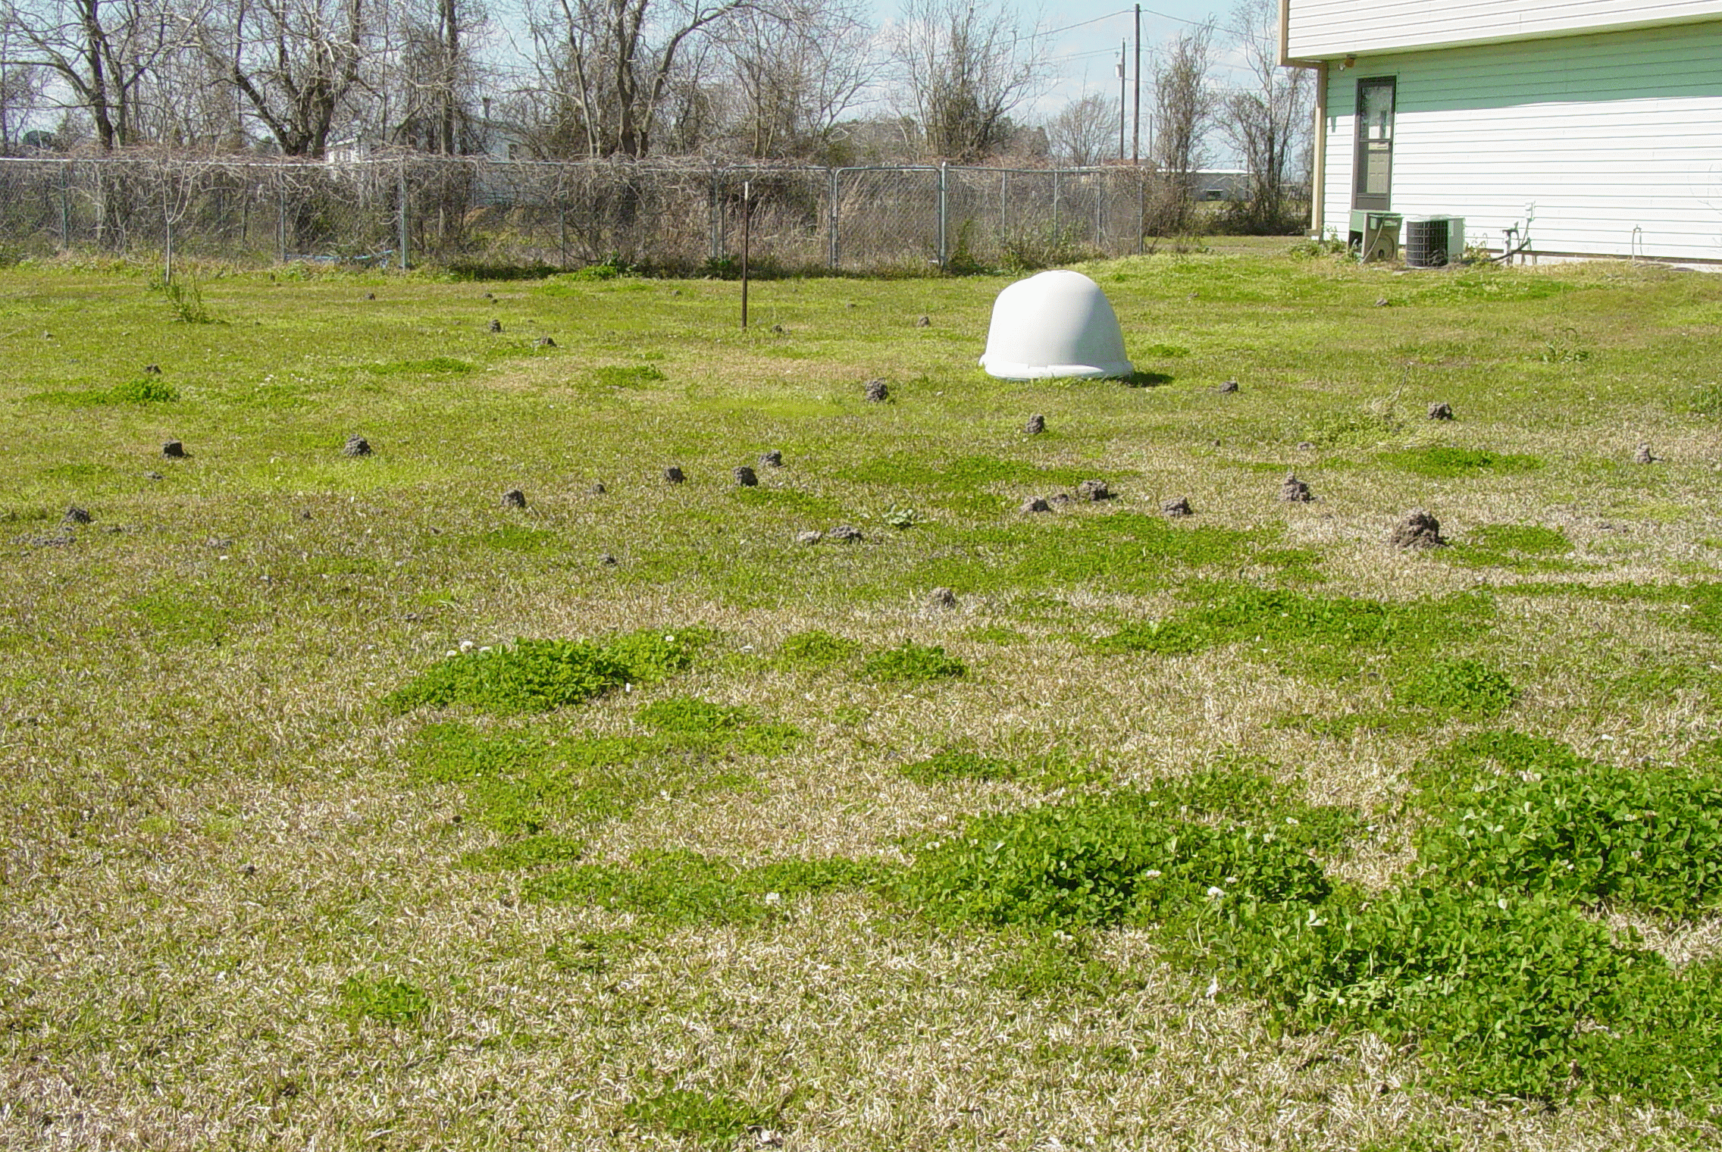
﻿
Organic Gardening Concepts
SUBJECTS COVERED
Soil
Compost
Plants
Plant Rotation
Mulching

Slide 3
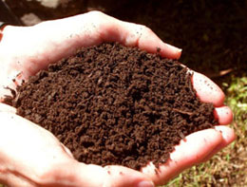
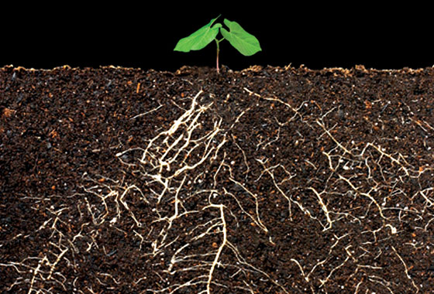
﻿
Organic Gardening Concepts
SOIL
Consider the needs of plants
Type: sand, silt, clay combo
Organic matter level
Moisture: drainage & irrigation
Micro-organisms: bacteria, fungi
Macro-organisms: earthworms, soil-related insects
Its all about growing healthy roots!

Slide 4
﻿
Organic Gardening Concepts
SOIL
Consider the needs of plants
  Proper amount of sun (>6 hrs)
  Soil rich in needed nutrients
  Soil with good oxygen penetration
Type: sand, silt, clay combo
  Best soil type is a sandy clay loam
Organic matter level
  Greater than 5%
  The more the better!
Moisture: drainage & irrigation
  Good drainage to a depth of 1 ft.
  Irrigation readily available
Micro-organisms: bacteria, fungi
  Micro-organisms are a result of organic matter levels
Macro-organisms: earthworms, soil-related insects
  Macro-organisms are a result of organic matter levels

Slide 5
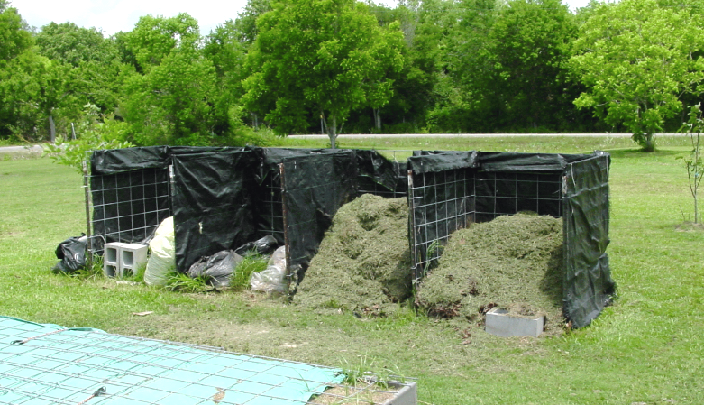
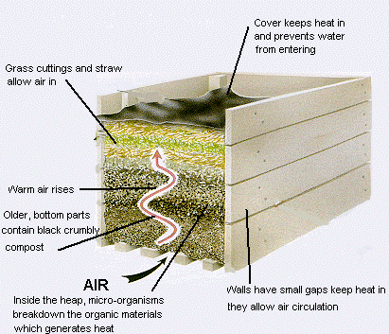
﻿
Organic Gardening Concepts
COMPOST
﻿Natures way to break down plant tissue
Organic material for nutrient availability
Use green & brown materials (1:1 ratio is best)
Check the Tº & pH

Slide 6
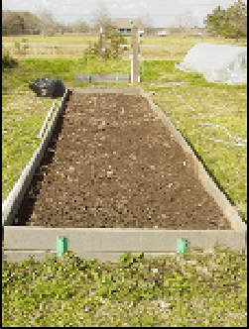
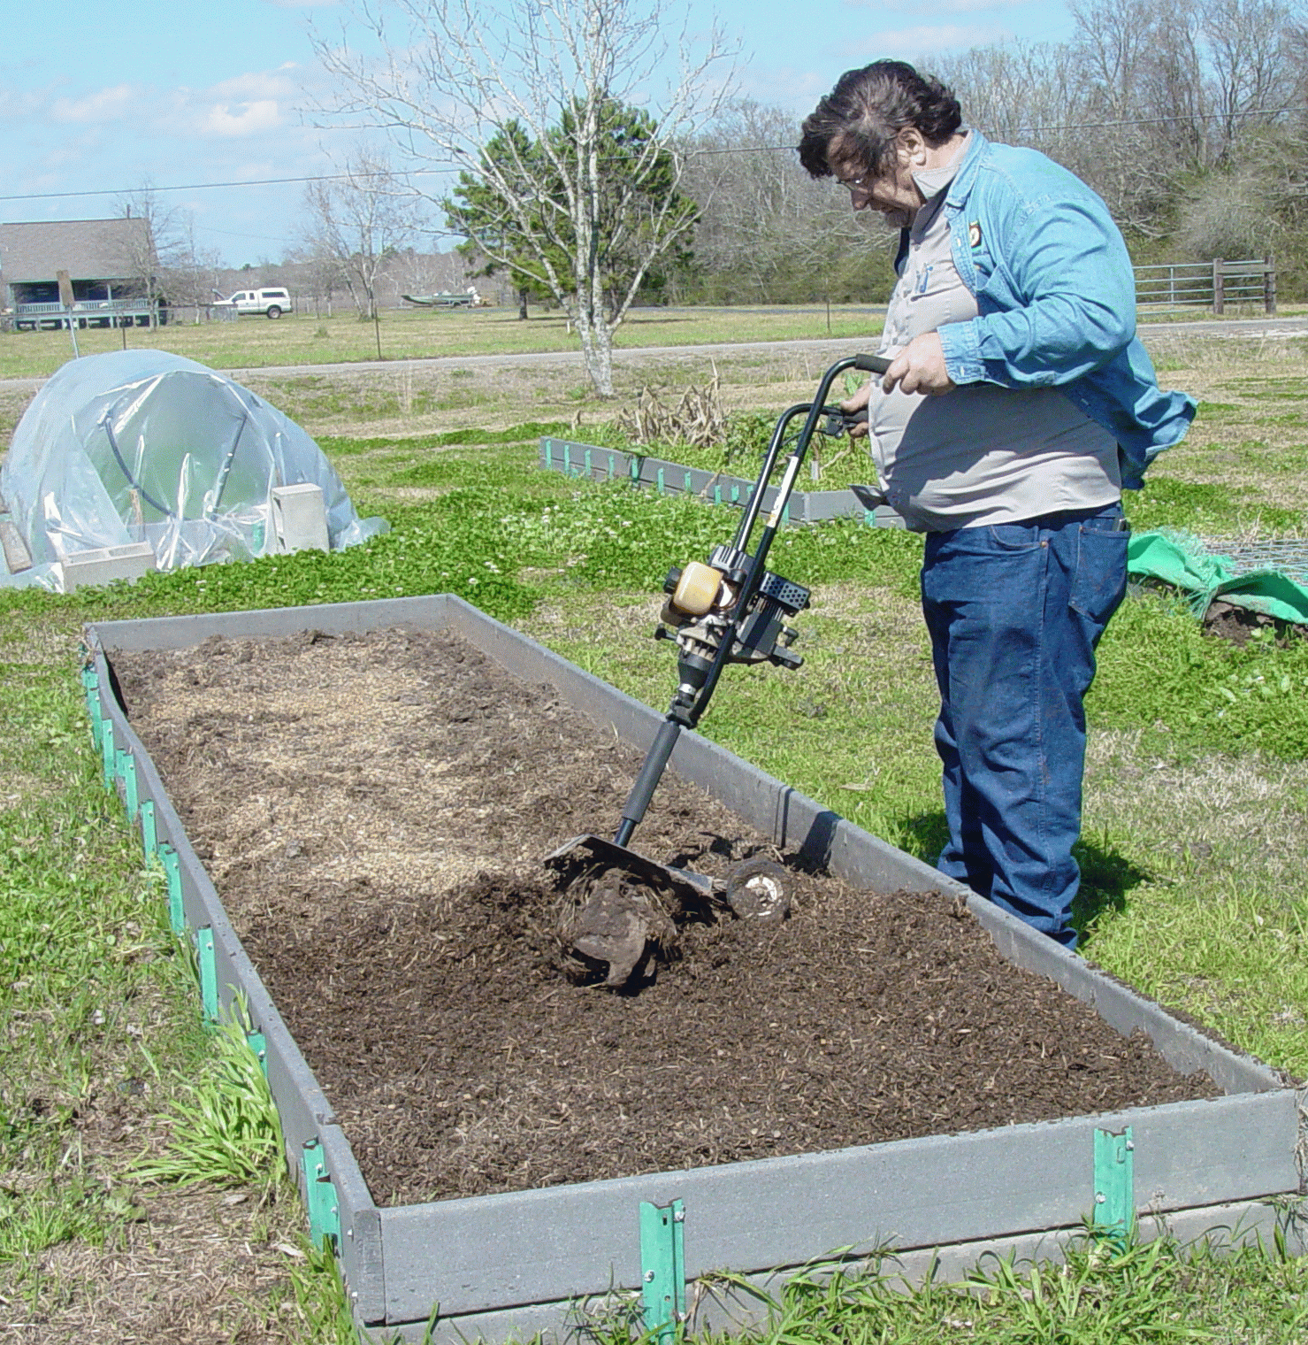
﻿
Organic Gardening Concepts
SOIL
﻿Spread 1 to 2 inches over the soil surface
Incorporate well into the top 6 inches

Slide 7
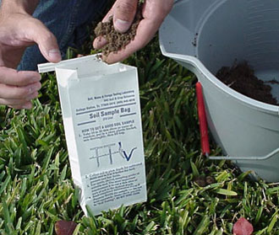
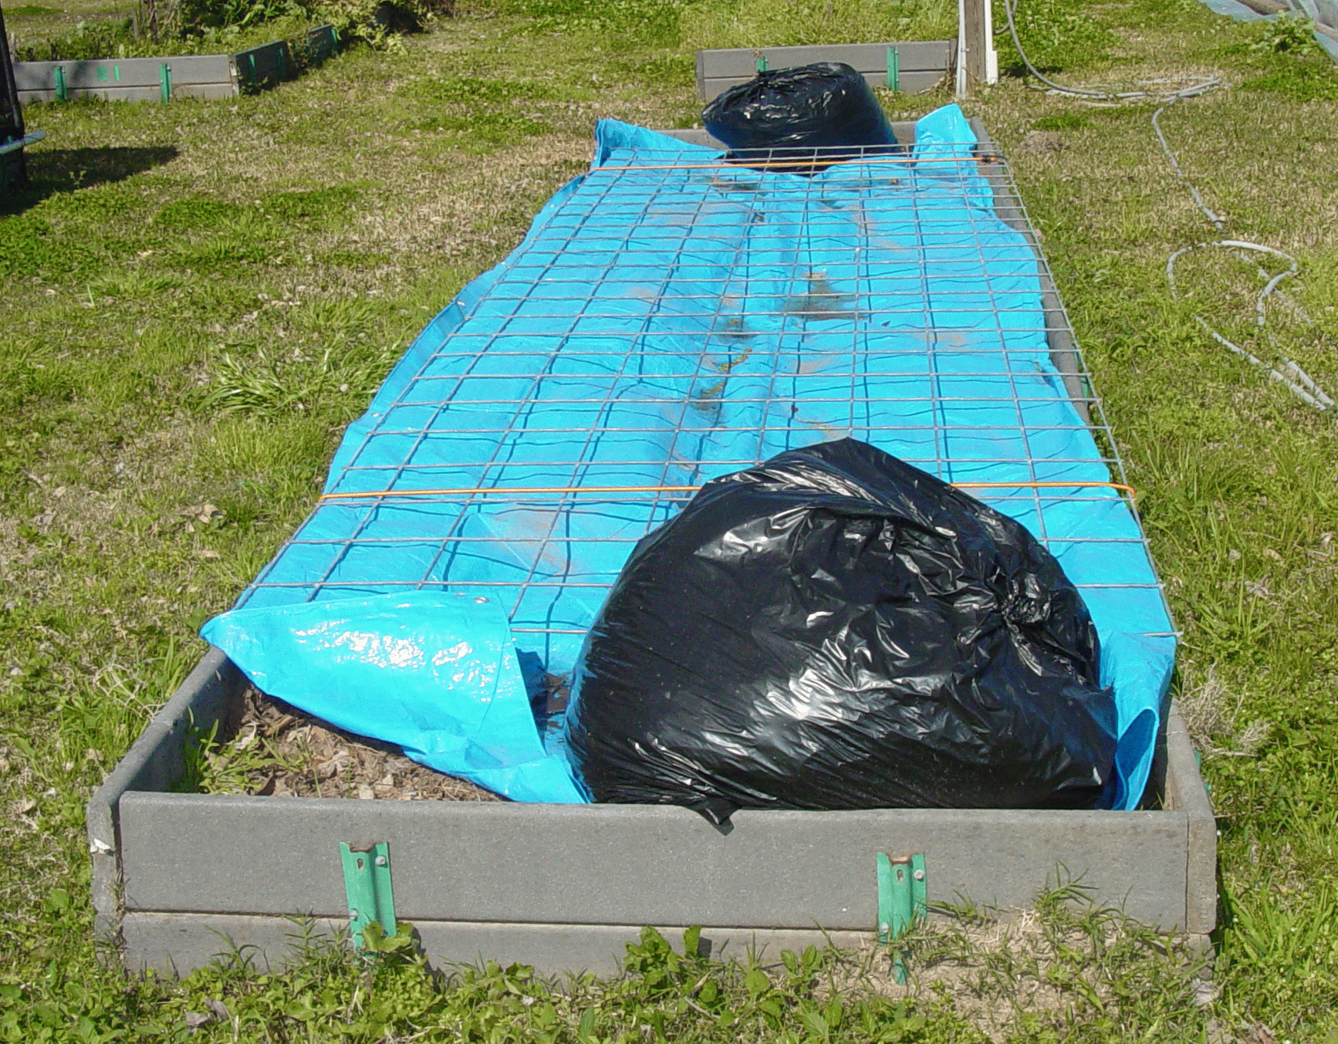
﻿
Organic Gardening Concepts
SOIL
﻿Spread 1 to 2 inches over the
soil surface
Incorporate well into the top 6 inches
Have the soil tested!
Keep covered until needed

Slide 8
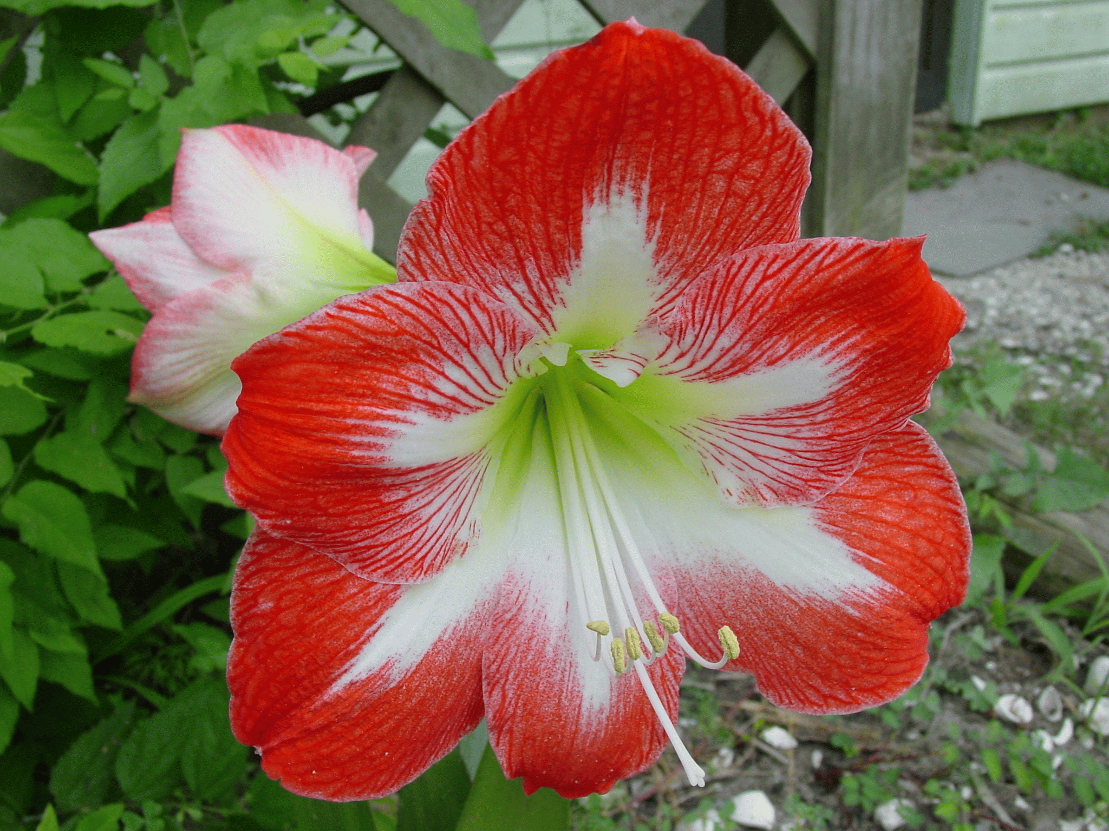
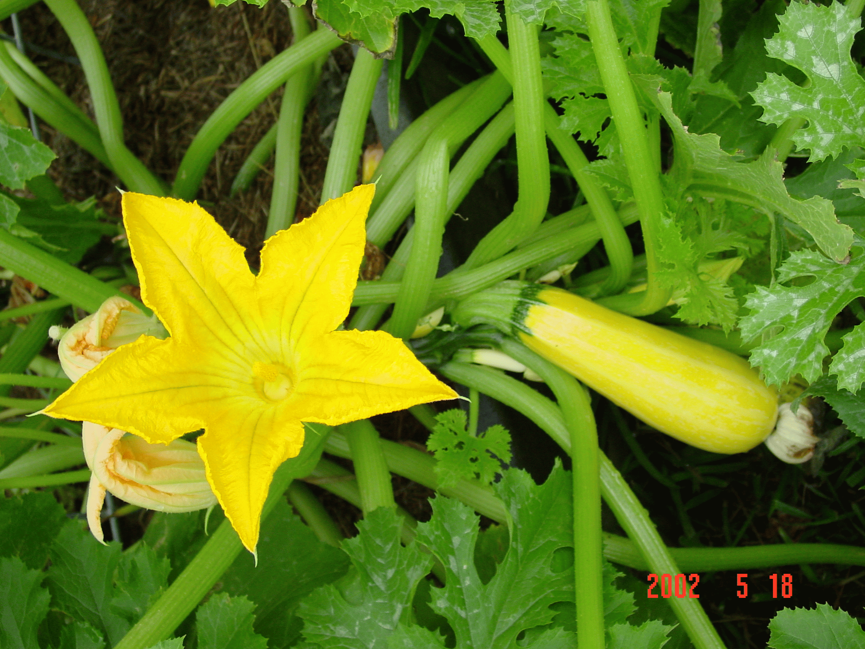
﻿
Organic Gardening Concepts
PLANTS
Choose plants hearty for your area
Consider:
  Resistant features
  Hybrids
  Open-pollinated varieties
  Heirloom varieties
Pay close attention to growing seasons

Slide 9
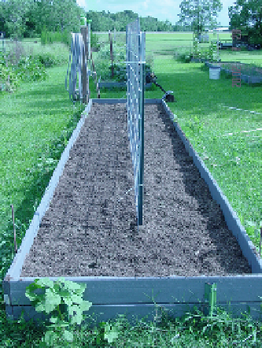
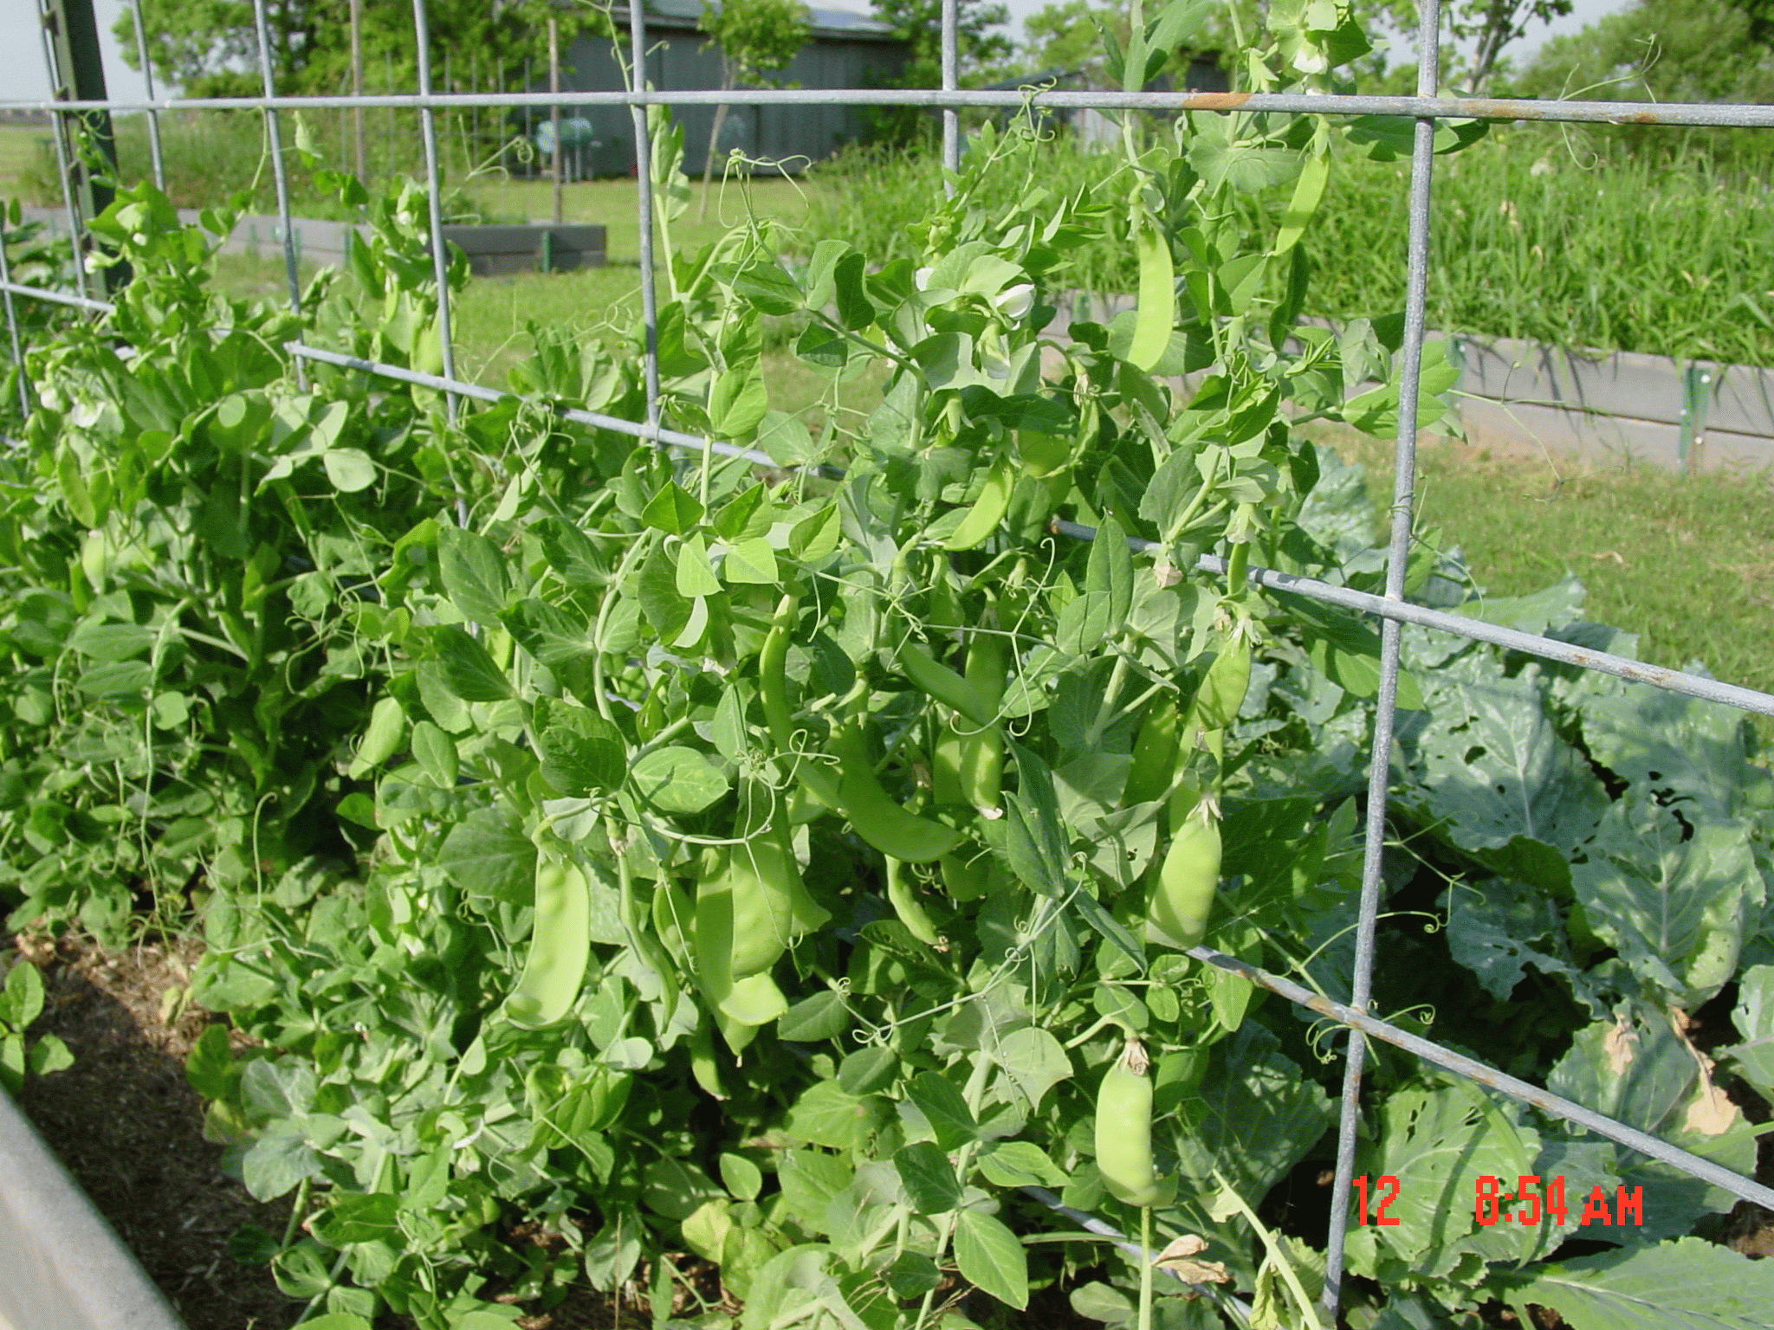
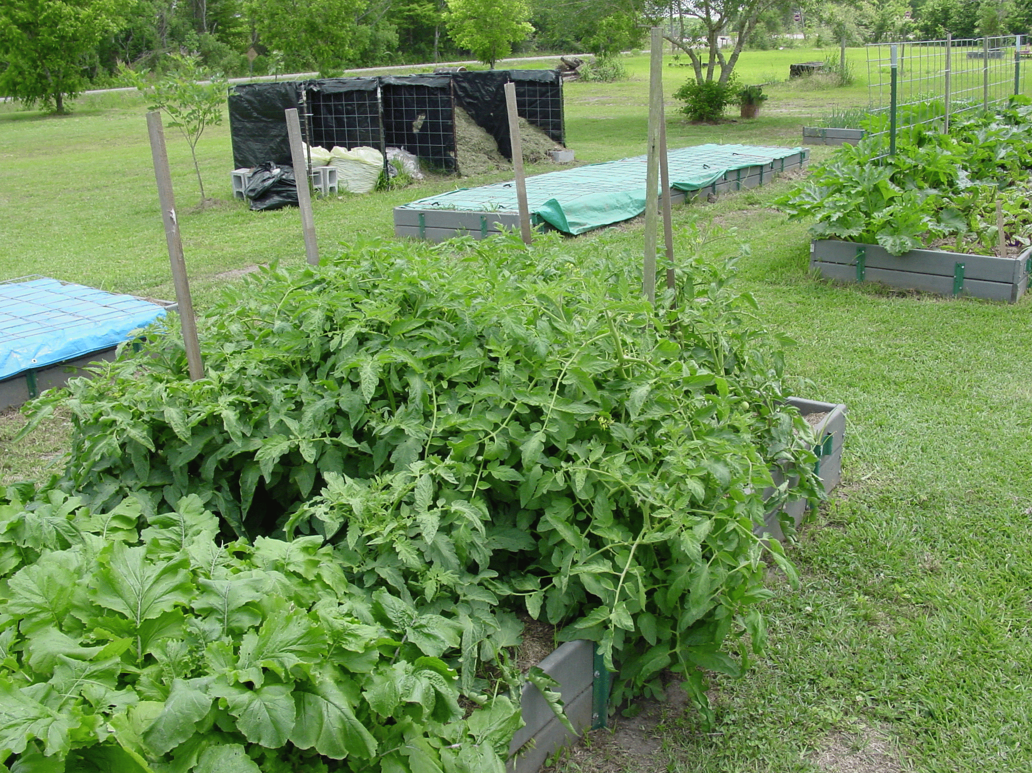
﻿
Organic Gardening Concepts

Slide 10
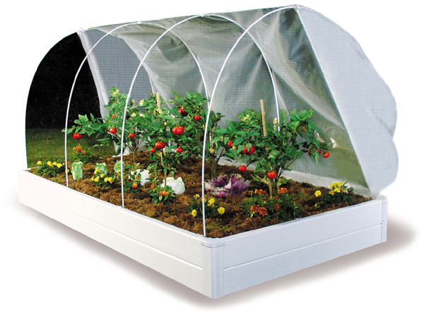
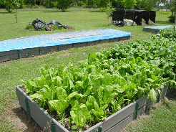
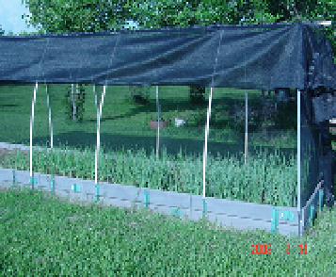
﻿
Organic Gardening Concepts

Slide 11
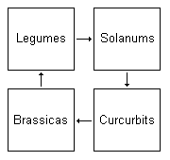
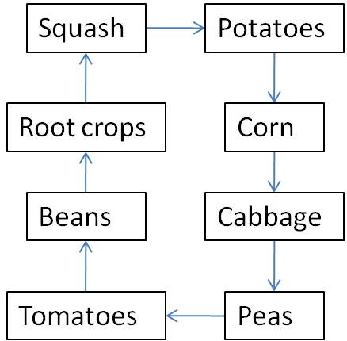
﻿
Organic Gardening Concepts
4-season crop rotation
CROP ROTATION
Reasons:
Soil Health – keep from depleting specific nutrients
For Pest Control:
  Insects – reduce invasion numbers
  Diseases – reduce soil-borne levels
  Weeds – help to combat weed levels
8-season crop rotation

Slide 12
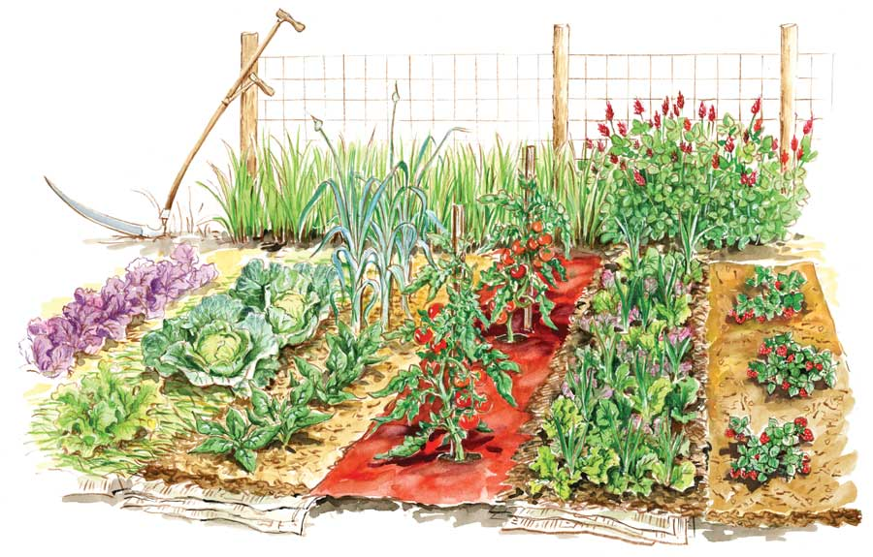
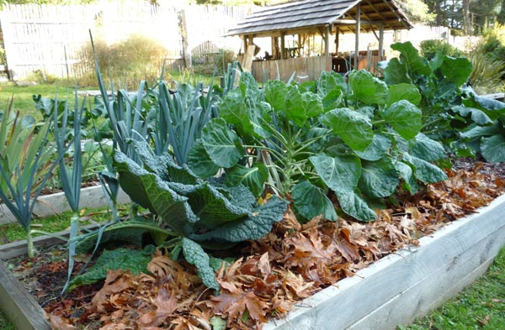
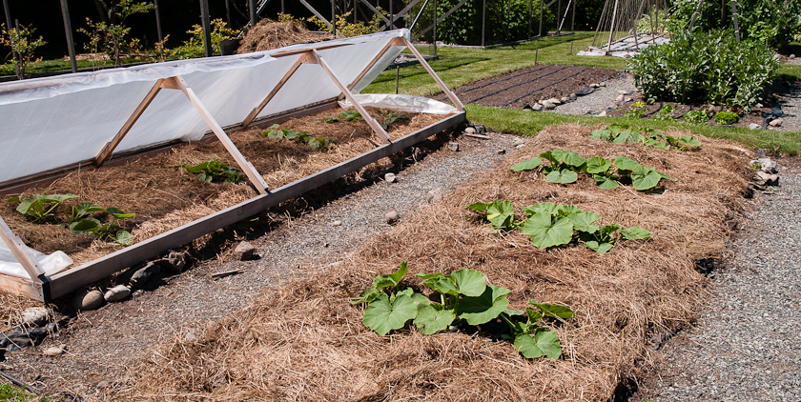
﻿
Organic Gardening Concepts
MULCHING -
Organic mulch is the 1st stage of compost
  Benefits of mulch:
  Regulates soil temperature
  Retains moisture
  Retards bolting
  Retards weeds
  Feed the plants

Slide 13
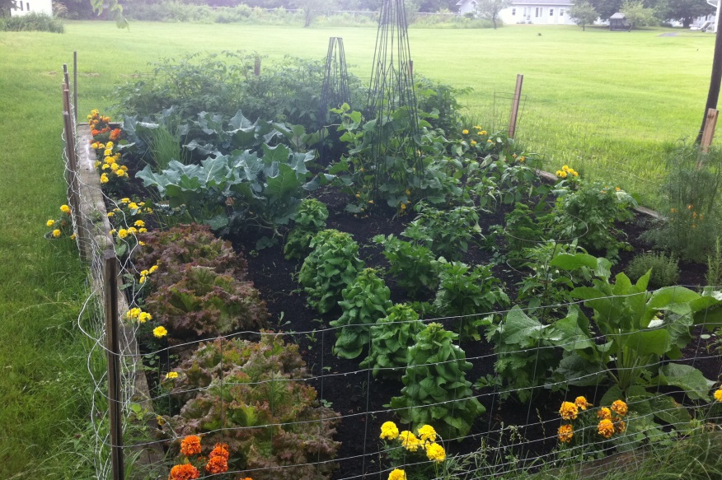
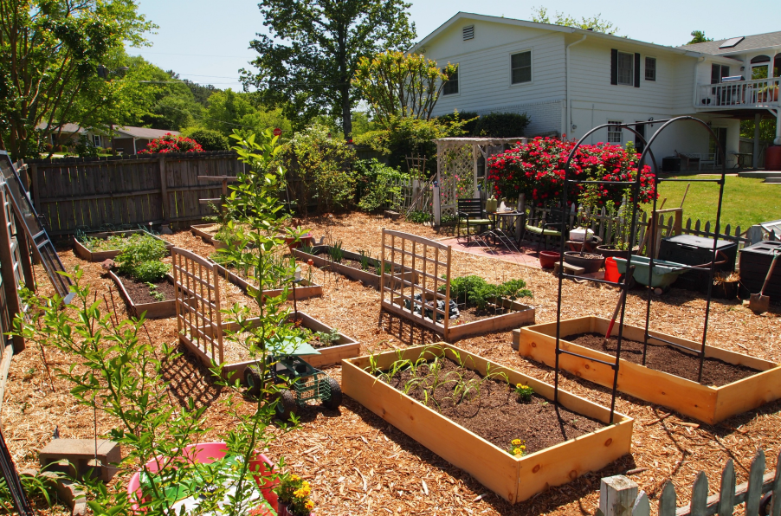
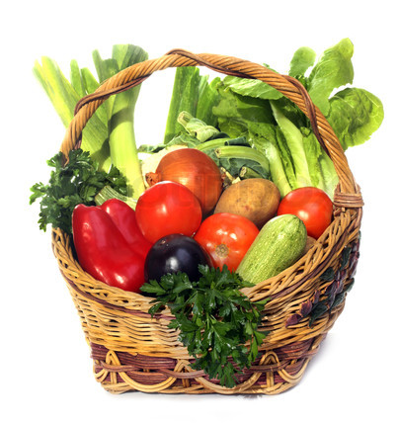
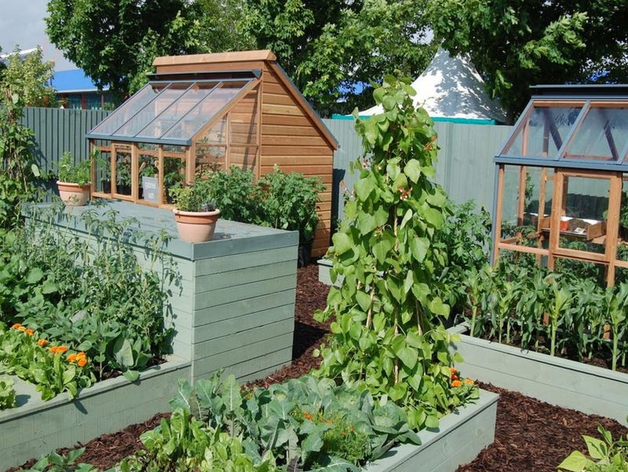
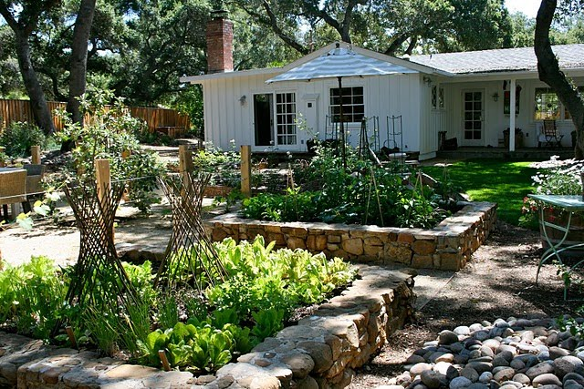
QUESTIONS?

