Slide 1
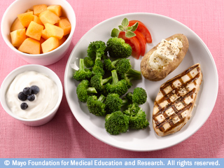
Meal Planning Made Easy
Image from google search

Slide 2
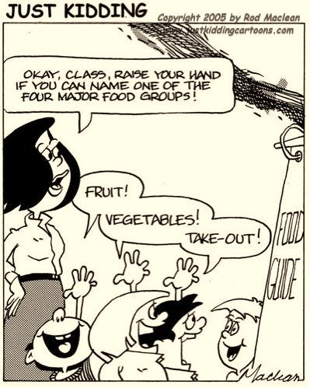

Slide 3
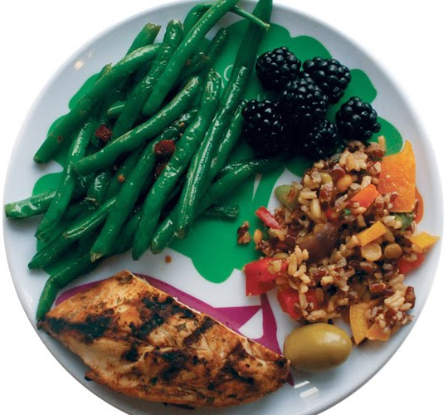
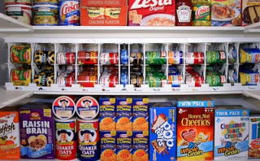
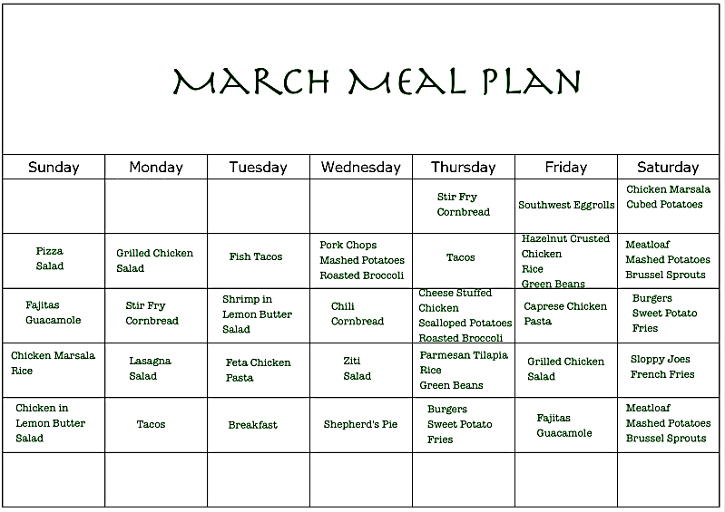
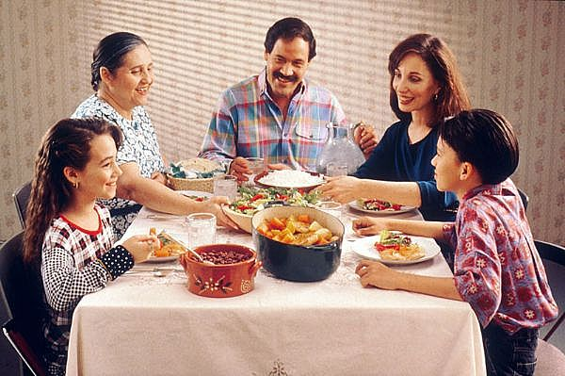
Meal Planning Basics
Balanced plate
Well-stocked pantry
The Sunday ritual
Plan it out!

Slide 4
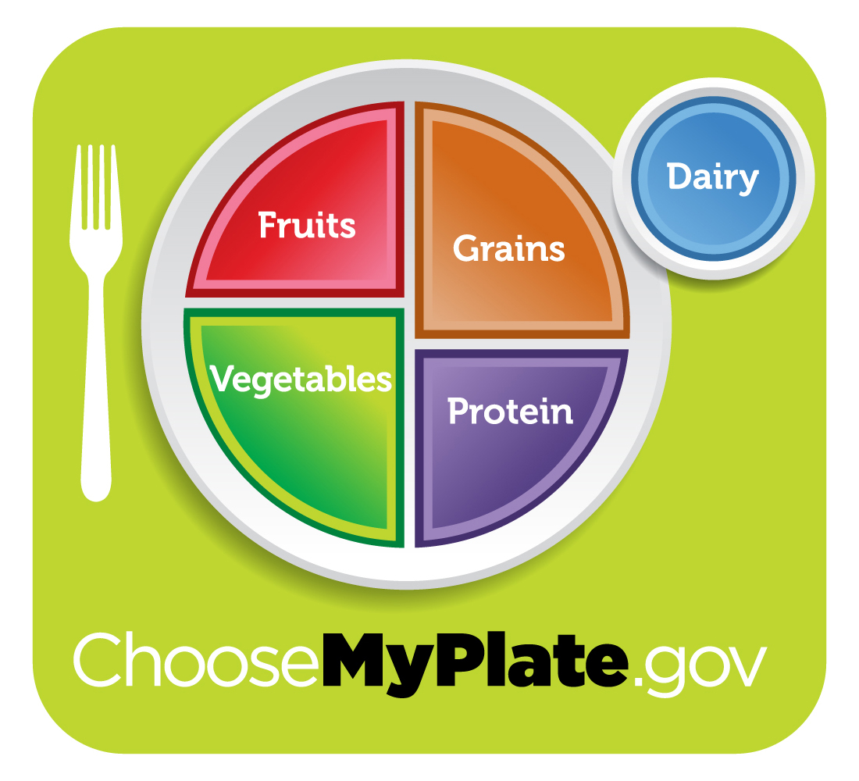

Slide 5
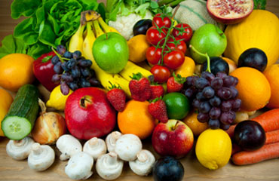
MyPlate Best Choices
Fruits
  Fresh, frozen without added sugar, dried (watch portion), canned in juice or light syrup
Vegetables
  Fresh, frozen without added sauces, canned (reduced sodium, rinse under water)

Slide 6
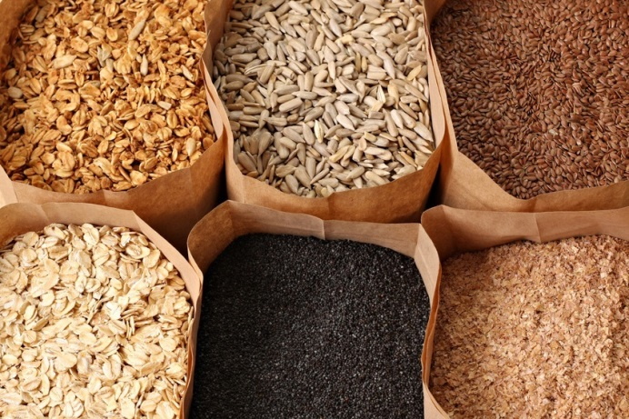
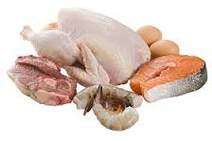

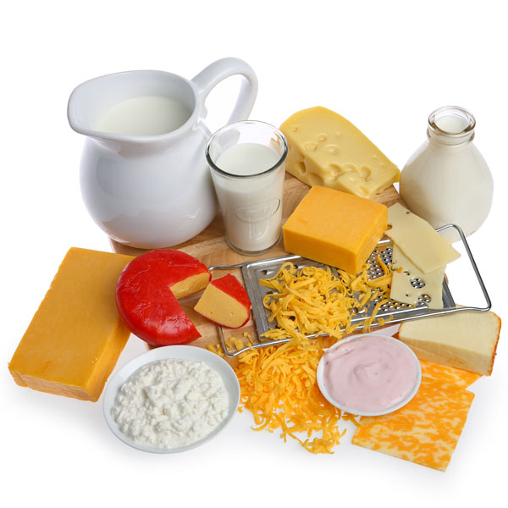
MyPlate Best Choices
Grains
  Whole grains—aim to make at least half of your grain servings whole
    Fiber, B vitamins, selenium, iron
  Examples: brown rice, whole wheat, quinoa
Protein
  Lean choices= less saturated fat
  Examples: fish, legumes, poultry without skin, lean cuts of been and pork (loin, round, flank), tofu, nuts/seeds
Dairy
  Low-fat or fat free

Slide 7
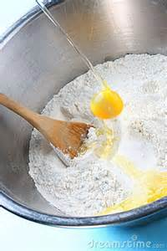
Keep a well-stocked pantry/frig.
Essentials: cooking oil (olive, canola), salt, pepper, chicken or veggie broth, lemon juice, breadcrumbs, favorite seasonings
10 staples:
  Garlic and onions
  Canned and/or dried beans
  Pasta/rice
  Eggs
  Frozen chicken breasts
  Frozen vegetables (spinach, peas, corn, mixed)
  Cheese (parmesan, feta, goat)
  Tomato sauce, tomato paste and/or canned tomatoes
  Vinegar (balsamic, red wine, white)
  Quinoa (or other favorite whole grain)
Other suggestions: milk, tortillas, frozen hamburger or ground turkey, canned tuna (in water)

Slide 8
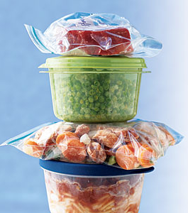
Keep a well-stocked pantry
Keep ingredients on hand for quick, easy favorites that can utilize leftovers
  Pasta
  Soup/Chili
  Salad
  Pizza
Keep a grocery list on refrigerator or in kitchen—make note if you run out of any of the staples
Only have to add a few ingredients and/or fresh produce to make a wonderful meal

Slide 9
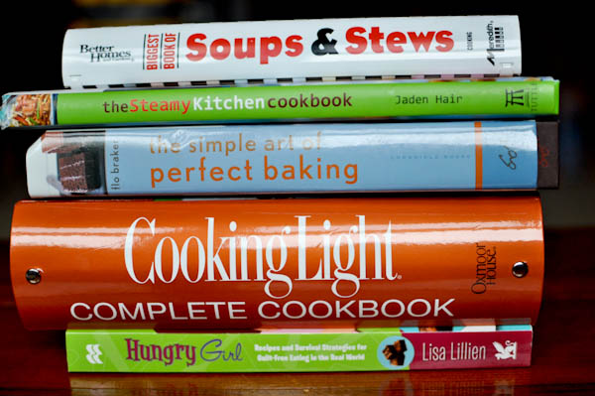
The Sunday ritual
The ritual
  Plan out meals
    Minimum or 3 cookbooks, online
  Grocery shop
  Chop vegetables, cook meat, mix spices, etc.
Write it on the calendar—make meal planning & prepation a priority
  Sunday afternoon/Saturday morning/weekday mornings/after dinner
    1-2 hours on the weekend= less stress during the week, healthier meals for you and your family
  Invest in good food storage containers

Slide 10
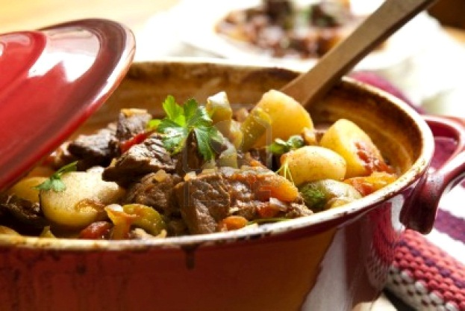
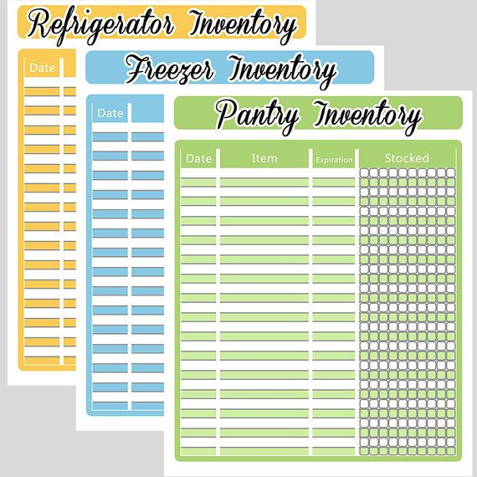
The Sunday ritual
Batch cooking
  The freezer is your friend!
  Good batch cooking ideas: lasagna, soups, casseroles
    Also: meatballs, taco meat, cooked beans & rice, shredded chicken or pork, meat w/ marinade
    Can freeze meal components
  Foods that do not freeze well: produce with high water content (lettuce, melon, citrus), flour thickened sauces & gravies, eggs, mayo, pasta (undercook)
  Thaw food safely—plan ahead
    Do not thaw on counter all day!
  Keep a list of what is in your freezer

Slide 11
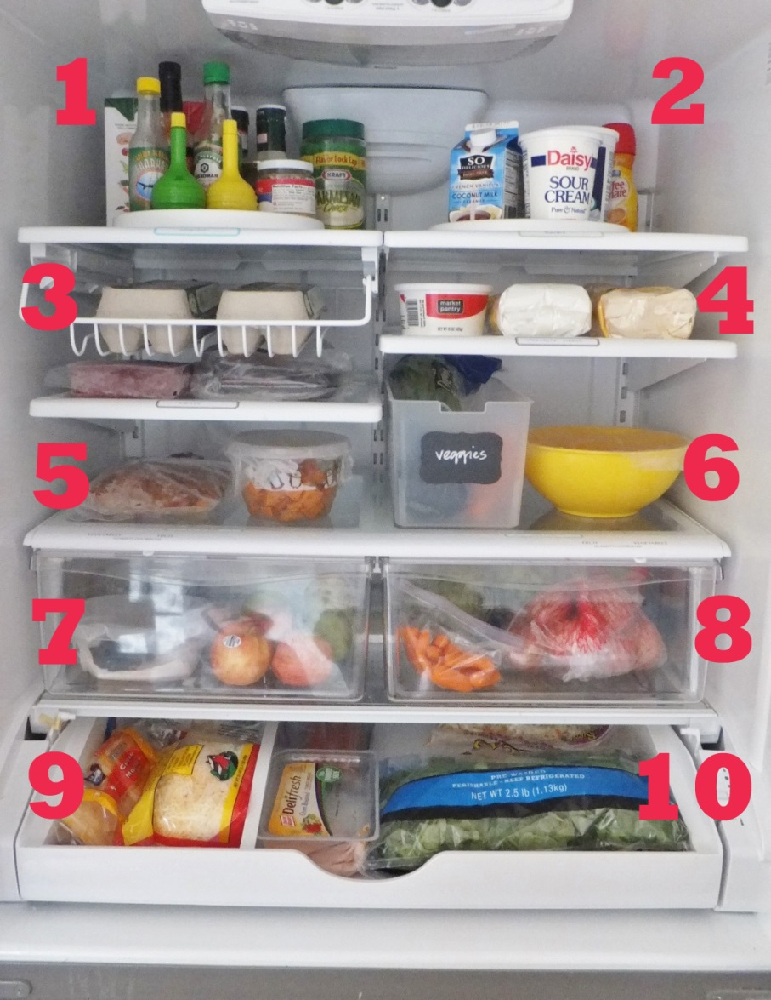
Plan it out!
  Refrigerator inventory
    What needs to be used sooner rather than later?
    Leftovers
  Look at schedule for the week
    Which nights do you have schedule commitments
    Think about amount of time you will have (if any) for meal preparation

Slide 12
Plan it out!
Meal selection
  Meat/protein
    Sales/coupons
    Mom’s method: One red, one white, one meatless, one leftover
      Add fish
    Healthiest protein choices: fish, legumes, poultry without skin, lean cuts of been and pork (loin, round, flank), tofu
  Starch
    Starchy vegetables: corn, peas, potatoes
    Whole grains w/faster cooking times: bulgur, quinoa, whole grain pasta
    whole grain bread

Slide 13
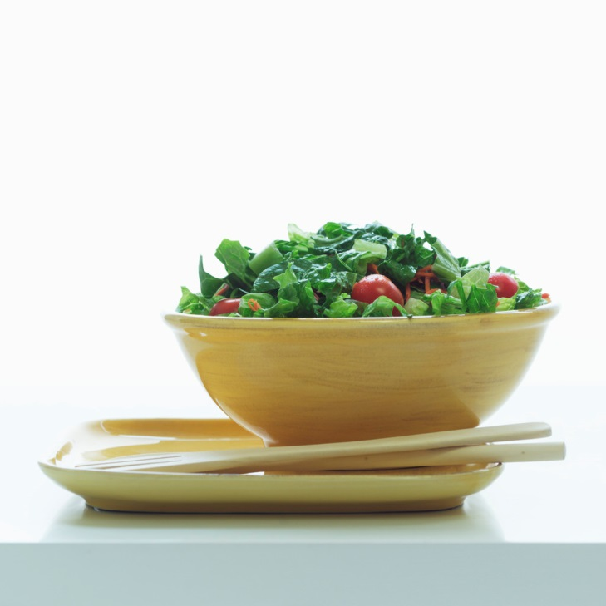
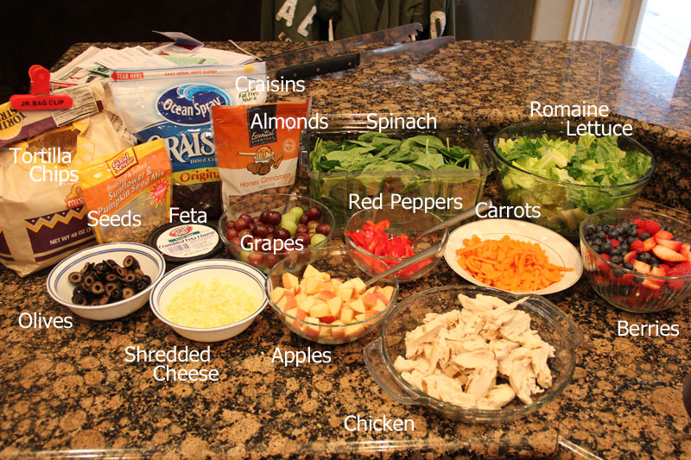
Plan it out!
Meal selection
  Vegetables
    Can base your meal around vegetables instead of meat
      Seasonal, farmer’s market, etc.
    Dark green/orange vegetables are most nutritious
    Frozen, canned= ok
  Salad fixings
    Spinach, romaine, spring mix
    Vegetables
    Dried fruit—cranberries, cherries, blueberries, raisins
    Nuts—almonds, pecans, walnuts, etc.
    Homemade dressing—get creative ☺
    Modify store-bought dressings

Slide 14
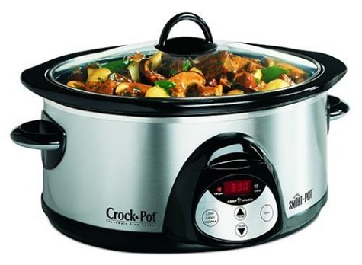
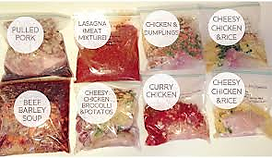
Plan it out!
Meal selection
  Other considerations
    Slow cooker
    Freezer meals
    Effort/time required for each recipe

Slide 15
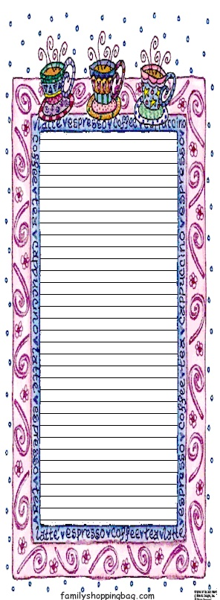
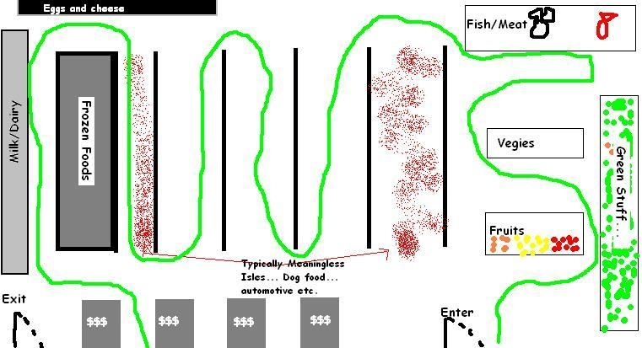
Plan it out!
Make a list
  Write down ALL ingredients for each recipe (even if you think you have it)
  Cross off each ingredient that you already have
  Combine with refrigerator door list
  Organize by grocery store section

Slide 16



And….!

Slide 17
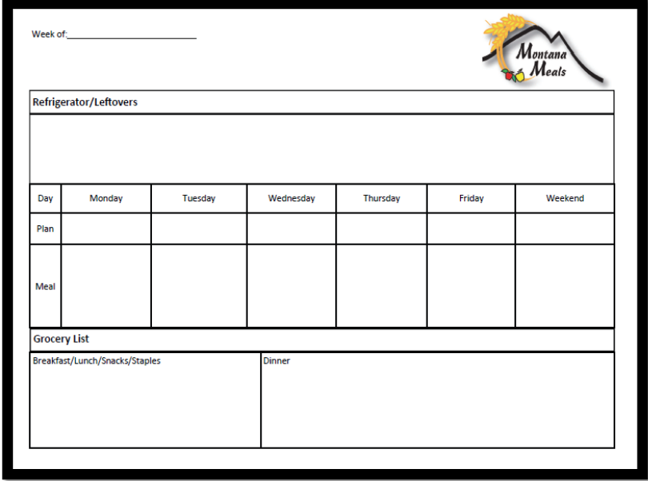
Notes to the cook listed here!
Lists very perishable stuff that needs to be eaten here
Lists weekly event/duties that might interfere with normal meal prep.
Lists daily menu
Based on the above daily menu lists needed ingredients to be purchased.

Slide 18
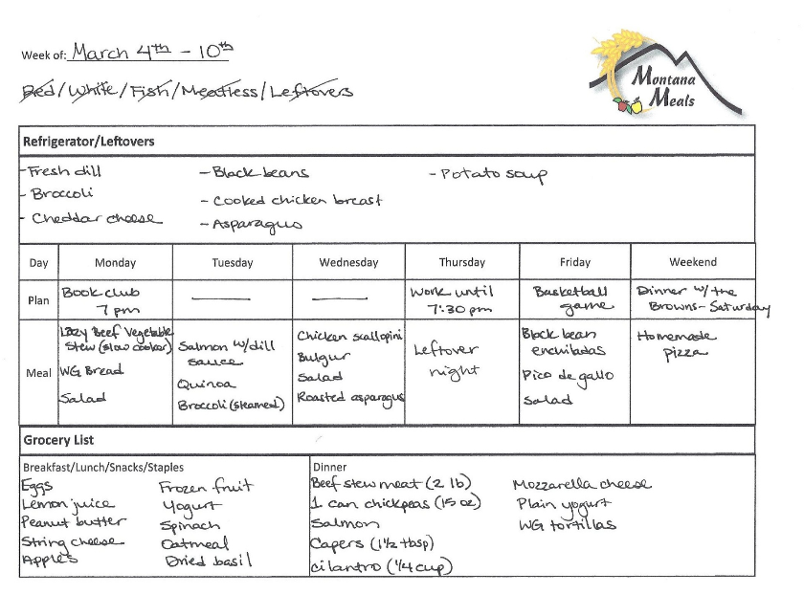

Slide 19
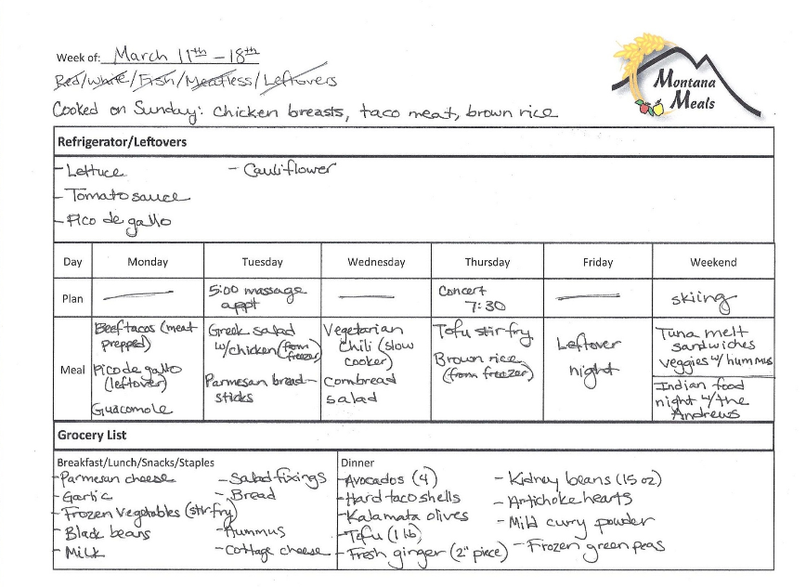

Slide 20
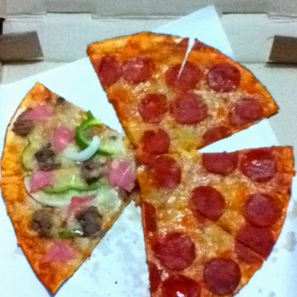
Meal Makeovers
Spaghetti
  Whole wheat spaghetti, sautéed veggies (broccoli, summer squash, onions), lean ground turkey in sauce, cheese for garnish
Tacos
  Whole wheat tortilla or taco salad with multigrain tortilla chips, extra lean ground been (90%+ lean), add black or pinto beans, romaine lettuce, avocado, salsa or pico de gallo, low-fat plain yogurt
Pizza
  Whole wheat crust, load up on vegetables (spinach, arugula, cauliflower, broccoli, peppers, etc.), lighter on the cheese

Slide 21
Other Meals
Breakfast
  Make ahead items: breakfast burritos (freezer), steel cut oats, whole grain pancake mix, healthy muffins
  Include protein: eggs, low-fat dairy, etc.
Lunch
  Consider balanced plate
  Intentionally plan leftovers
Snacks
  Fruits/veggies
  Include two different food groups
  Late afternoon snack to keep hunger in check while cooking dinner

Slide 22
Questions?
Edited by:
Vincent Mannino
County Extension Director – Fort Bend
Reference:
Stokes, C. (2013, April 3). Meal Planning Made Easy. Retrieved February, 13, 2014, from http://www.gfcmsu.edu/cmsAdmin/uploads/Meal_Planning_Made_Easy_Workshop_Packet.pdf .

